Slide 1
Tennessee Statewide Model v.4
TNMUG Meeting
Vince Bernardin, PhD, Preston Elliot, Steven Trevino
February 26, 2020

Slide 2
Agenda
Review of TSM History
Socioeconomic Data Update
Network Update
General Model Enhancements
Big Data for 2018
Alternative Long-Distance Passenger Model
Model Calibration & Validation
CAV Framework

Slide 3
Review of TSM History

Slide 4
Versions of the TSM
TSM Version 1
2005 – Bob Rock & PBS&J
2014 – Bob Rock & RSG
2016 – Chin-Cheng Chen & RSG
2020 – David Lee & RSG
TSM Version 2
TSM Version 3
TSM Version 4

Slide 5
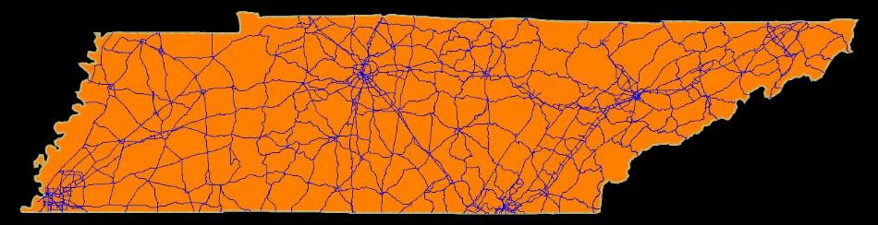
TSM Version 1
Completed 2005
2003 Base – 2030 Horizon
Only Total Daily Traffic
  No truck volumes, no multimodal info
Limited Network Coverage & TAZ (1,397)
  Not even all state routes
Limited Sensitivity
  Fixed trip tables (counts only)
  Re-routing Only

Slide 6
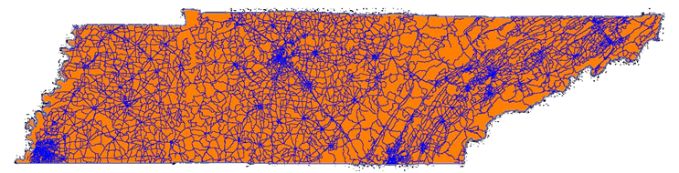
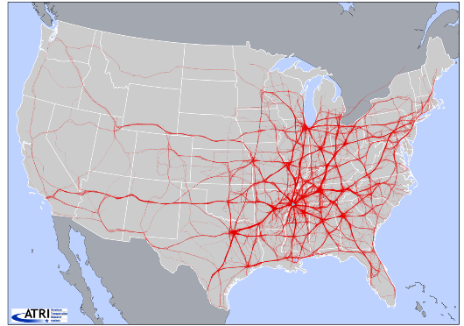
TSM Version 2
Completed 2014
2010 Base – 2040 Horizon
Total Daily Traffic
  Autos & Trucks
Expanded Network Coverage & TAZ (3,684)
  Roughly triple the detail as Version 1
Improved Sensitivity & Accuracy
  Incremental three-step model
  pivoting on ODs from big data

Slide 7
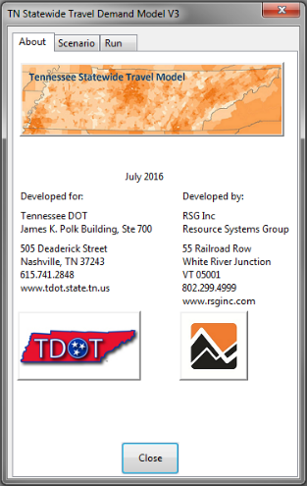
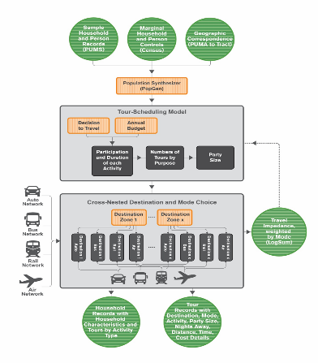
TSM Version 3
Completed 2016
2010 Base – 2040 Horizon
Multimodal Freight Commodity Flows
  Trucks, Rail, Intermodal, Water
Advanced trip-based model to replace 3-step
  Mode & Destination choice models, linked NHB trips
    Transit & Non-motorized trips
Incorporate New National
Long-Distance Model
  Calibrated to AirSage
  Air travel, Amtrak & intercity bus

Slide 8
Since TSM v. 3
TSM Version 3
2015 – 2016
2016 – 2018: CAVs & Visitor Models
2017 – 2019: Feedback & Toll Models
2018 – 2020: New rMerge data & Ensemble Framework
2020
Michigan
North Carolina
Illinois
TSM Version 4

Slide 9

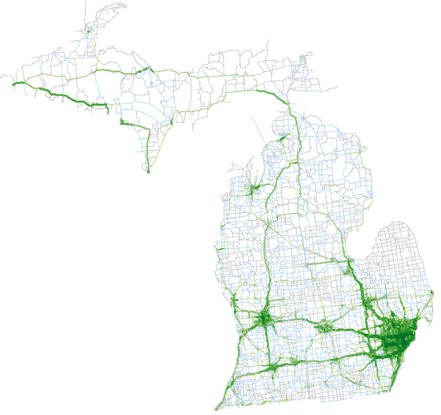
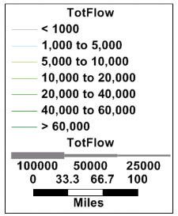
The New Michigan Statewide Model
One of the longest traditions of statewide modeling in the country since early 1970’s
Last major update was mid 1990’s
New model complete
early 2019
Special Models:
  CAVs
  Summer (tourism)

Slide 10




CAVs in Michigan
Home of the Auto Industry
  All auto-makers actively
  investing in CAV technology
Public-Private Partnerships
  Research rapidly moving into reality
    U of M has been using autonomous shuttles for almost a year

Slide 11




Michigan Tourism
Visitors injected $24.7 billion into Michigan economy in 2017
Which results in $2.7 billion in state tax revenue (compare to $1.2 billion gas tax revenue)
These figures have increased more than 25% since 2010

Slide 12
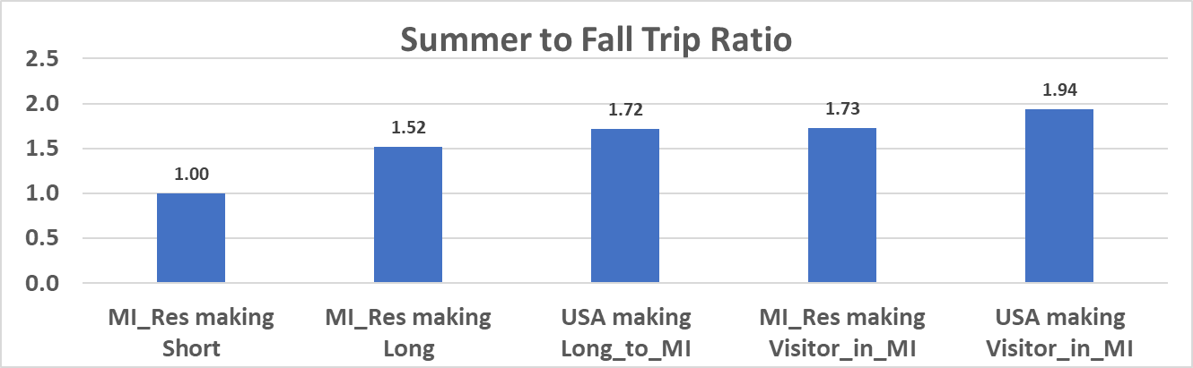
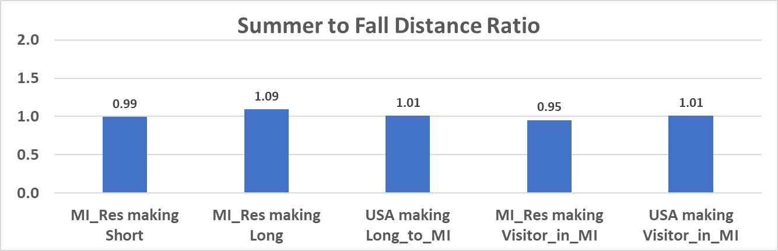
Summer / Fall Comparisons

Slide 13
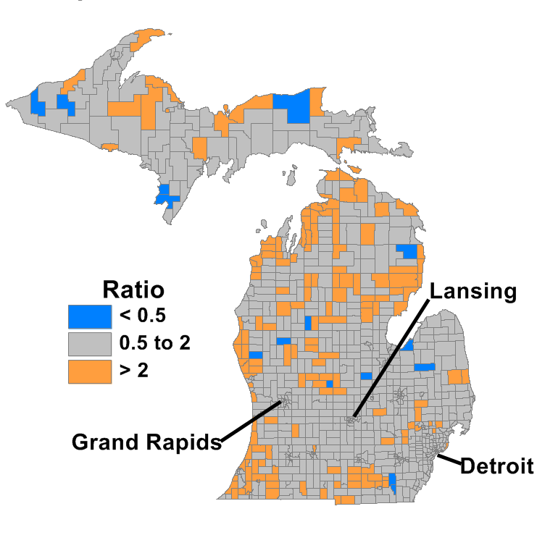
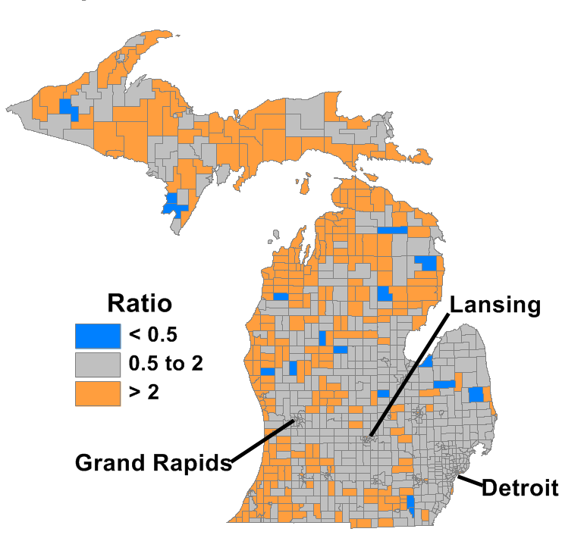
Observed Summer to Fall Ratio:
Long Distance and Visitor Trips
Long-Distance Destinations
Visitor Trips

Slide 14

North Carolina
North Carolina’s project prioritization
process for transportation funding
  legislatively mandated
  largely quantitative
  statewide model plays a key role
Recently, the state has begun building tolled facilities
  Triangle Expressway (traditional toll road)
  I-77 Express Lanes (HOT lanes)
In order to fairly evaluate these types of projects, the statewide model needed to be updated to incorporate toll modeling.

Slide 15
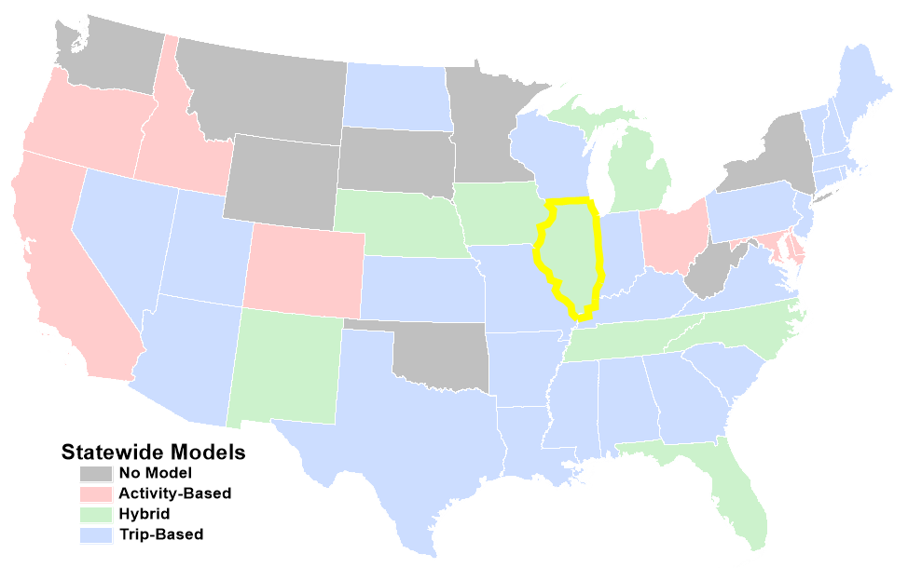
40 States Have Now Developed a Statewide Model!

Slide 16
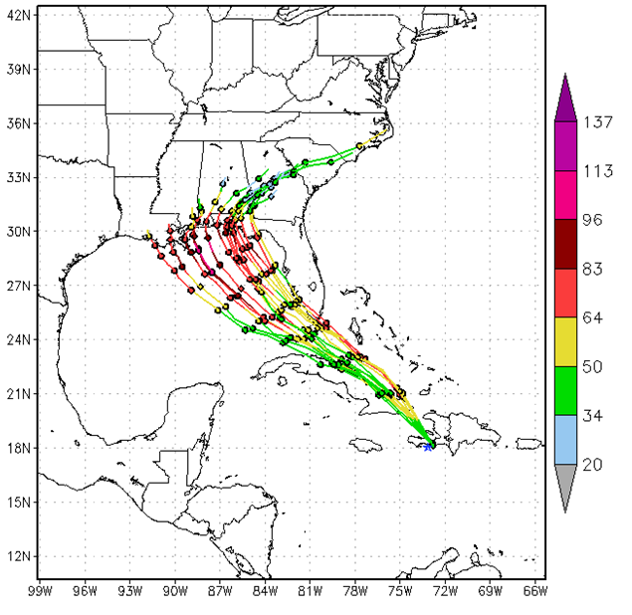
Ensemble Modeling & Forecasting
Combine multiple forecasts into a “consensus” forecast via binding function
Works best with different (uncorrelated) models
Can also “boost” with models in series
Has led to greater predictive validity
(e.g., in meteorology)
Ensemble Forecast of Hurricane Isaac - noaa.gov

Slide 17
Deep Thoughts…
“All models are wrong; some models are useful.” – George Box
Different models are wrong in different ways
Being wrong in multiple ways allows you to better understand how you are wrong
Multiple models are more useful

Slide 18

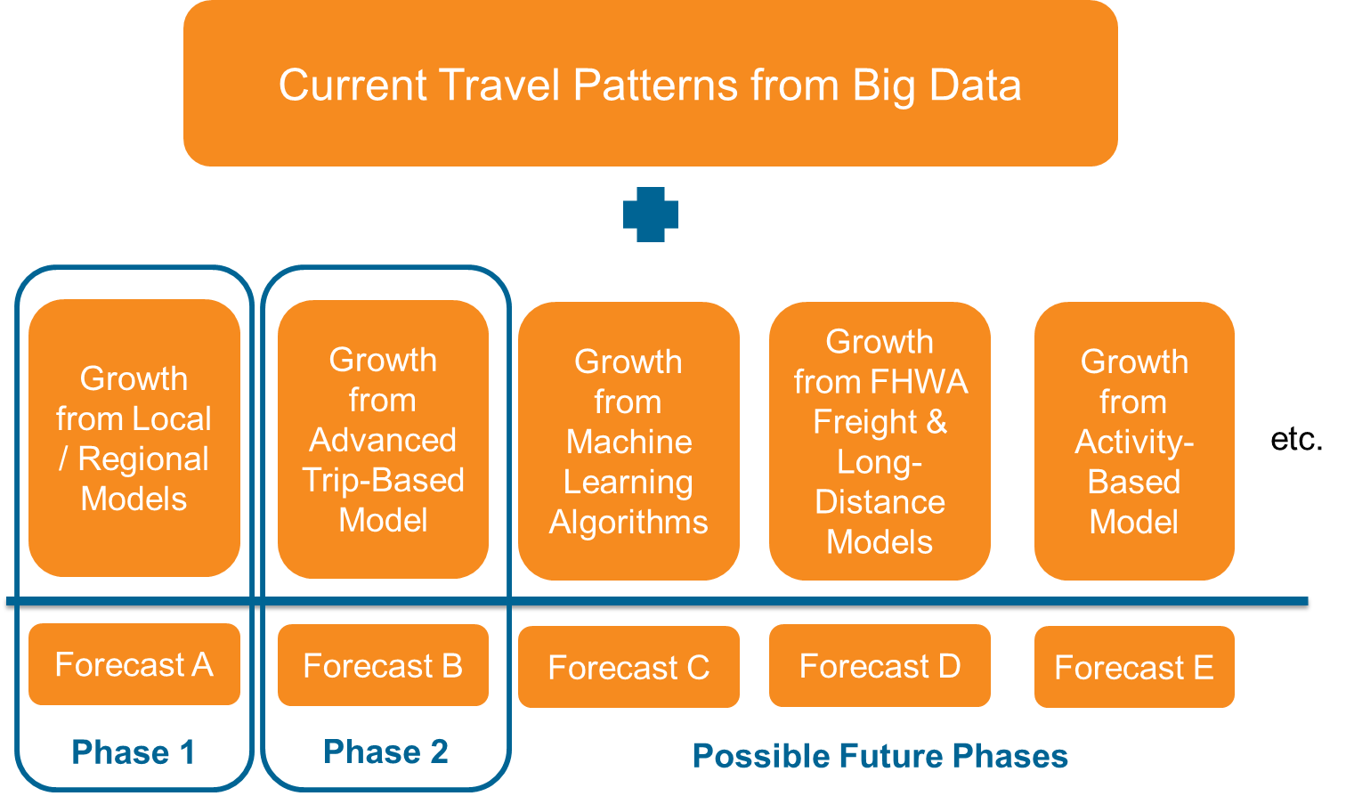
ILSTDM’s Extensible Modular Framework

Slide 19

Updating Base without Recalibration
Base ODs can be updated without recalibrating demand models

Slide 20
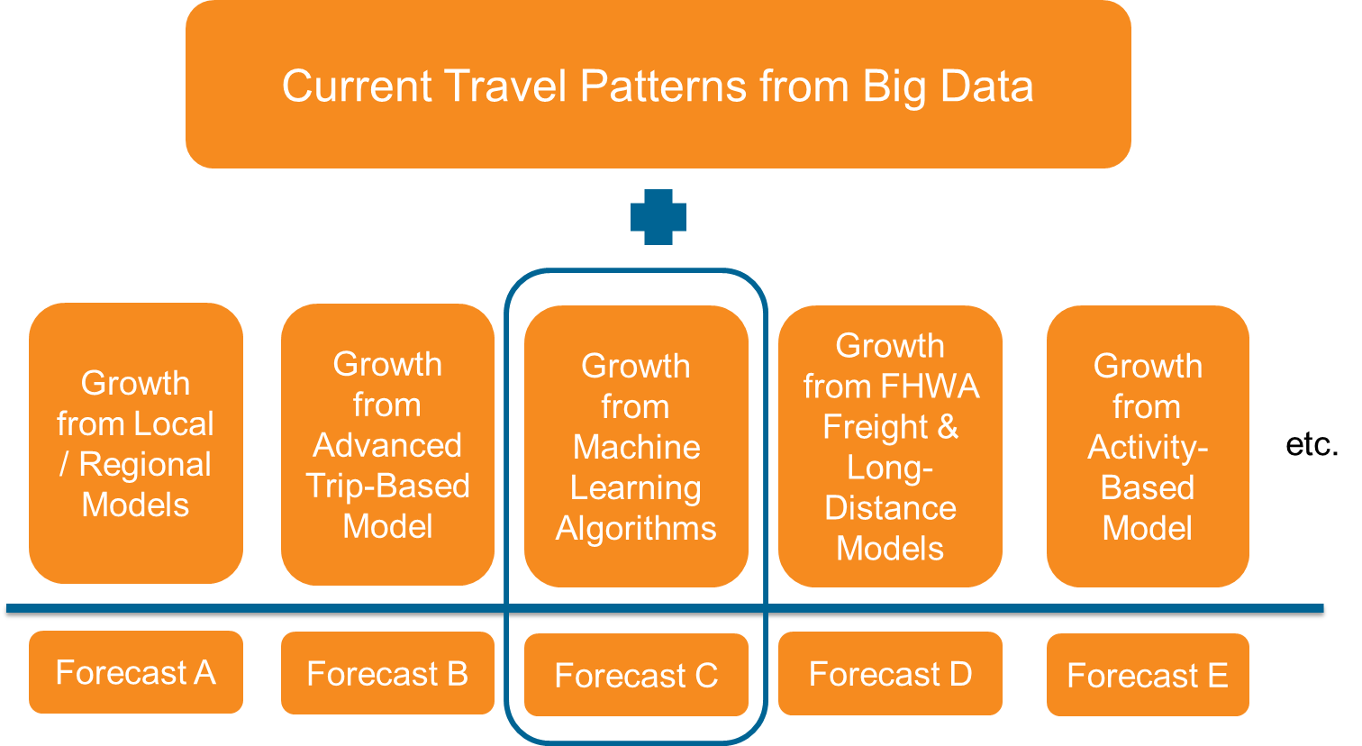
Addressing New Changing Behaviors/
Patterns without System Recalibration
Shopping to Delivery Boosting Model
Adding new modules for new functionality instead of rebuilding
Forecast A’
Forecast B’

Slide 21
Update Socioeconomic Data

Slide 22
Socioeconomic Data
KCI will be working to update the statewide model to a 2018 base year and a 2045 horizon year using the following sources:
DATA SOURCES
  ACS 5-Year Estimates
  MPO Travel Demand Models
  Woods & Poole
  InfoGroup
  UT Center for Business and Economic Research (CBER)
  Bureau of Economic Analysis (BEA)
  Longitudinal Employer-Household Dynamics Survey (LEHD)
2018 Population |  |  | 2045 Population
US Census | Woods & Poole | UT Forecasts | Woods & Poole | UT Forecasts
6,770,000 | 6,771,300 | 6,770,000 | 7,667,300 | 8,068,600
UT +1.3M
W&P +900K
 | 2018 | 2025 | 2035 | 2045
Employment | 4,073,400 | 4,447,580 | 4,974,660 | 5,463,540
Notes:
ACS – 2014-2018
LEHD – 2017
InfoGroup – 2019
Woods & Poole – 2019 (2050)
UT CBER – 2019 (2018-2070)

Slide 23
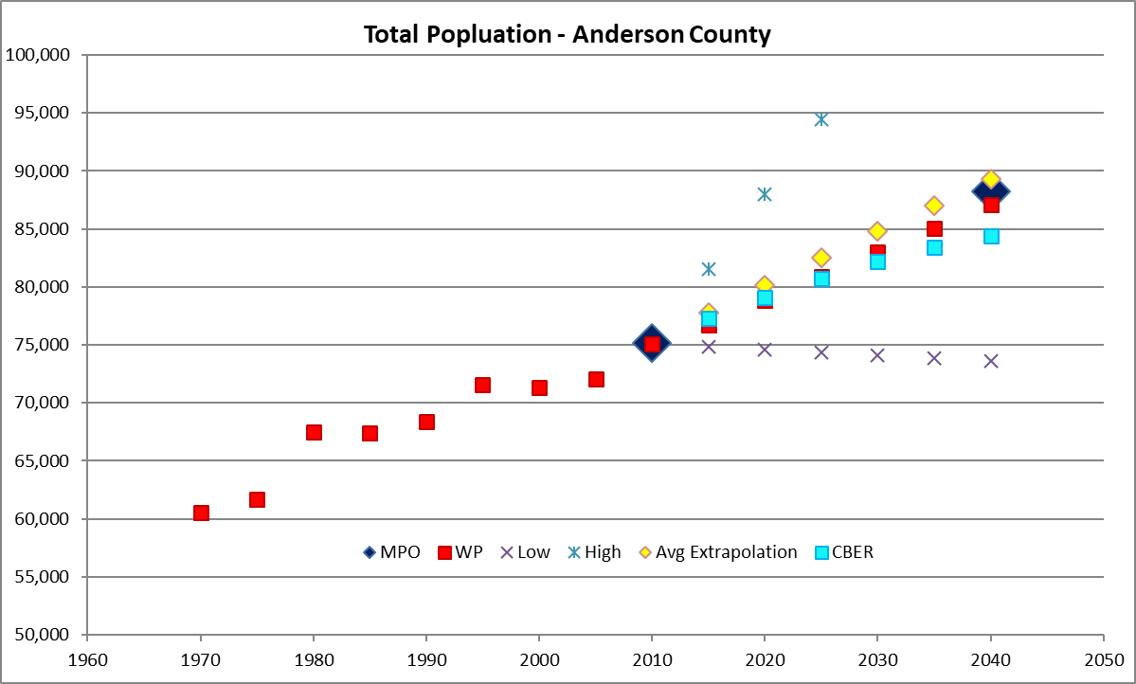
Methodology
  Similar to last statewide model update, a methodology will be developed to compare the population and employment control totals by county for all applicable data sources.
Two Stage Process
  Two-stage process used for both Population and Employment
  First, develop county-level control totals
  Second, down-allocate growth from county to TAZ

Slide 24
Base Year Consistency
  KCI will review the existing traffic analysis zones from the statewide model and compare to current MPO model structures to ensure consistency.
  Population and employment growth in TAZs located within urban areas will be coordinated with MPOs to establish 2018 base year conditions.
 | Base Year | Future Year
Bristol MPO | 2010 | 2040
Chattanooga TPO | 2014 | 2045
Clarksville MPO | 2016 | 2045
Cleveland MPO | 2013 | 2040
Jackson MPO | 2015 | 2045
Johnson City MTPO | 2015 | 2045
Kingsport MTPO | 2015 | 2040
Knoxville TPO | 2014 | 2040
Lakeway MTPO | 2014 | 2040
Memphis MPO | 2010 | 2040
Nashville MPO | 2010 | 2040
TDOT Model | 2010 | 2040
Notes:
ACS – 2014-2018
LEHD – 2017
InfoGroup – 2019
Woods & Poole – 2019 (2050)
UT CBER – 2019 (2018-2070)

Slide 25
County Control Totals – Population Process
Sources of Forecasts
  UT’s Center for Business and Economic Research (CBER)
  Historic Census growth rates and trends
  Woods & Poole
  MPO forecasts
Recommended Control Totals
  If 3 sources (rural population)
    use middle estimate
  If 4 sources (urban population)
    If MPO forecast is not highest or lowest, use it
    If MPO forecast is highest, use second highest
    If MPO forecast is lowest, use second lowest

Slide 26
County Control Totals – Population Results
Example

Slide 27
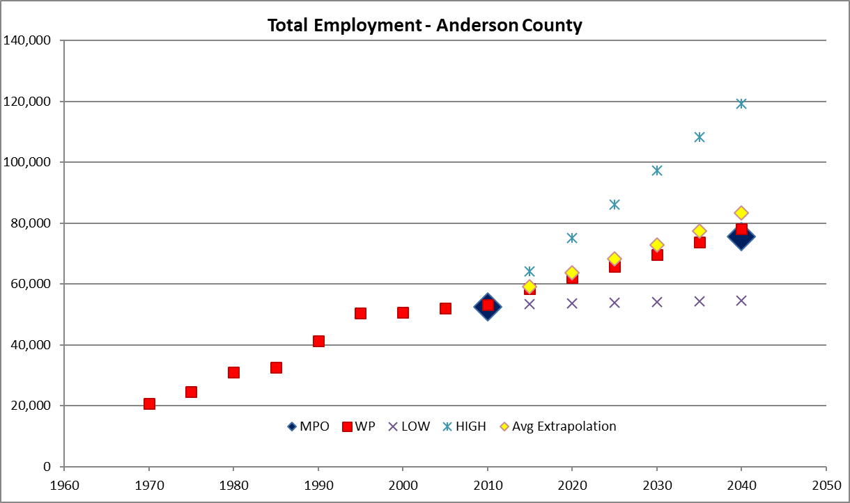
County Control Totals – Employment Process
Sources of Forecasts
  Historic growth rates and trends
  Woods & Poole
  MPO forecasts
Recommended Control Totals
  If 2 sources (rural employment)
    If W&P within 10% of historic,
    use it, otherwise average with
    historic
  If 3 sources (urban employment)
    use middle estimate

Slide 28
County Control Totals – Employment Results
Example

Slide 29
Jobs to Persons Check
Reasonable Ratios
  Make sure that ratios are consistent with knowledge of the nature of the locale (e.g., bedroom community, regional employment hub, self-contained, etc.)
Reasonable Change
  Make sure that any significant changes in ratio correspond with assumed changes in nature of county
  Especially question declining ratios in generally improving economy

Slide 30
Allocation to TAZ – MPO Areas
TSM Control Totals * MPO TAZ Shares
  MPO TAZ share of MPO forecast county growth calculated
  Share applied to TSM county growth
  MPO TAZ aggregated to TSM TAZ
  Absolute growth may not match exactly where control totals differ, but same pattern will be assumed
  Except Memphis (model was out of date and being revised at the time)
  Imposed a floor of 30% of current population / employment to limit declines in some areas

Slide 31
Allocation to TAZ – Rural Areas
Mixed Historic Growth and Growth-in-Place
  Used 2000 – 2010 historic population growth at the block level from Census
  Used 2002 – 2012 historic employment growth at the block level from LEHD
    Except in some neighboring states (AR/MS: 2003/4 – 2011)
  Historic growth showed overly pessimistic employment declines in too many TAZ due to the great recession
  Factoring existing employment up to forecast control totals (growth-in-place) showed too much growth in too many TAZ
  Average of Historic and Growth-in-Place were ultimately used
    Declines were again limited to -70%

Slide 32
Review & Development of 2018 Network

Slide 33
Review & Development of 2018 Network
Investigate simplification of national network to improve Long Distance Model runtimes
Add STIP & TIP projects that have been introduced since 2010
Identify IMPROVE Act projects and implement into future network scenarios

Slide 34
Review & Development of 2018 Network
Update network vehicle count database for 2018
Update capacity estimation using HCM 6th Edition
Add slope data based on TDOT’s LIDAR data

Slide 35
5-Year Historical Count Database
Data Cleaning Procedures
First, throw out any bad years
For each station calculate front weighted mean
  2018 = 5 2017 = 4 2016 = 3 2015 = 2 2014 = 1
Compare each year’s count with the weighted mean for possible removal
    Volume < 1,000 - acceptable error = +/- 200%
    Volume < 2,500 - acceptable error = +/- 100%
    Volume < 5,000 - acceptable error = +/- 50%
    Volume < 10,000 - acceptable error = +/- 25%
    Volume < 25,000 - acceptable error = +/- 20%
    Volume < 50,000 - acceptable error = +/- 15%
    Volume > 50,000 - acceptable error = +/- 10%
Second, throw out bad / erratic stations
Coefficient of Variation (CV) was calculated once all the outlier AADTs for each station and each year had been removed.
Stations were dropped if CV was > 15% and if standard deviation was > 100.

Slide 36
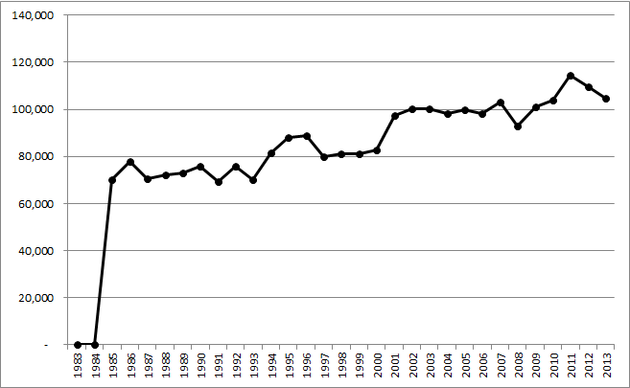
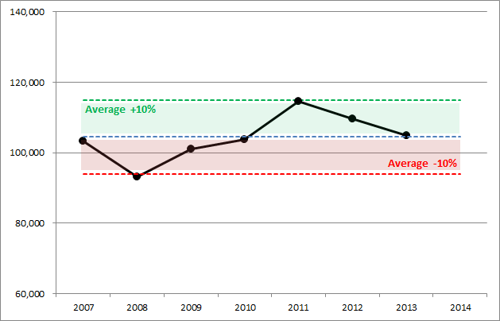
5-Year Historical Count Database
30-year AADT profile
STATION_ID = 37000317; I-40 in Davidson County
A total of 213 stations were removed (out of 12,297) due to this process as either being outliers or otherwise suspicious data
Will use min, max, mean, median (ignoring outliers)
Volumes on this segment of I-40 have varied +/- 10% over the last five years

Slide 37
General Model Enhancements

Slide 38
General Model Enhancements
Model update to TransCAD 8
Updated GUI, configuration file, & model logging
Review of runtime with feedback
Update to non-auto inputs

Slide 39
Walk Index (Walkability)
  Based on literature review and RSG research
  Calibrated/validated across multiple projects
  More sensitive to outlier zones (bad or good walkability)
  Variables:
    (+) Z-Score of Intersection Density
    (+) Z-Score of Attraction Density
      (4.1 * RetailEmp + 4.1 * FoodEmp + 1 * HHPop)
    (-) Z-Score of Industrial Emp Density
    (-) Z-Score of Basic Emp Density
`
Z-Score: Standard Deviations away from Mean

Slide 40
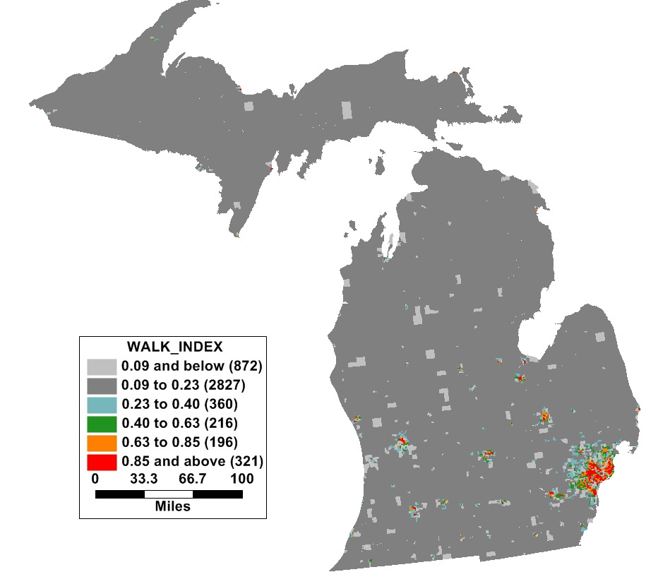
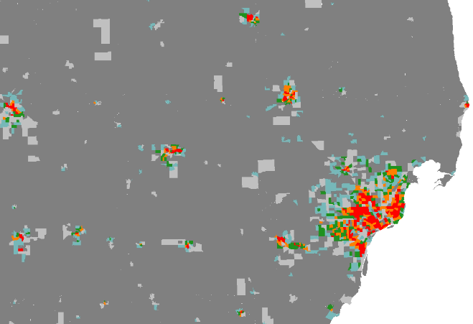
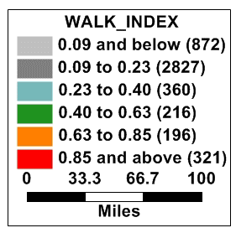
Walk Index (walkability)
Compared 20 Locations
w/ Walk Score:
.70 Correlation

Slide 41

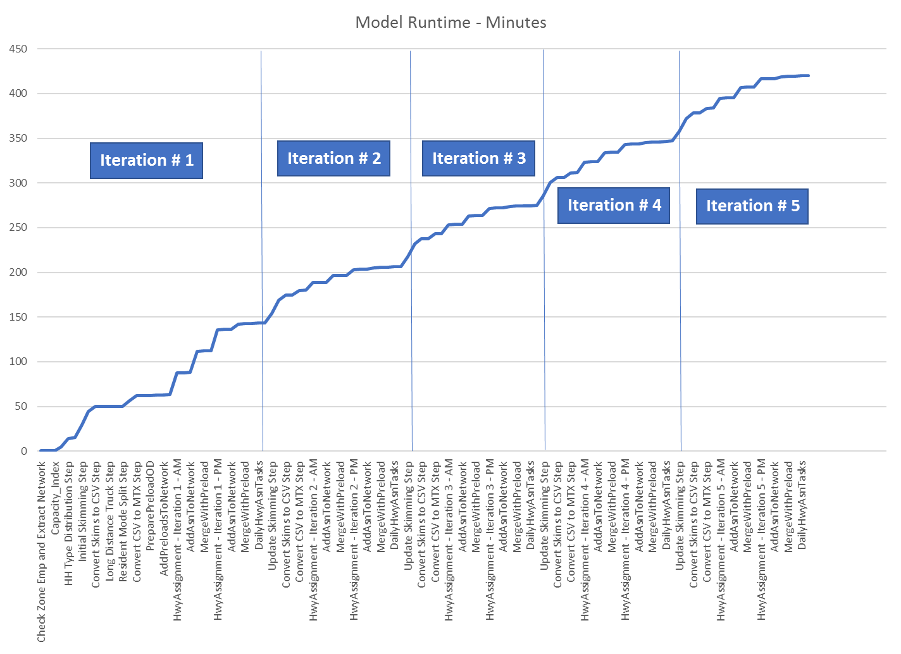
Run Time Analysis of NCSTM

Slide 42
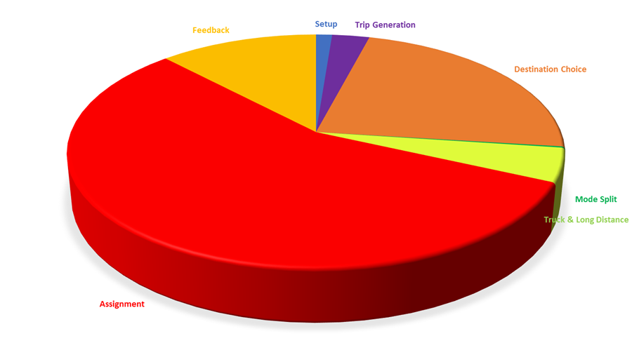
Run Time Analysis
NCSTM RUN TIME IMPROVEMENT
  Assuming unnecessary macro calls are removed, remaining run time is dominated by assignment (56%) and destination choice (23%)

Slide 43
Modification to Model Periods
Analysis of statewide time-of-day count data
Model update to support peak-period capacities, distribution, assignment
Update of pivoting process to pivot separately for each period rather than daily level

Slide 44
Incorporation of Big Data for 2018

Slide 45

Introducing…
rMerge
  High-quality passive data products
  enriched and validated with traditional data and
  grounded in RSG’s deep expertise in travel behavior

Slide 46
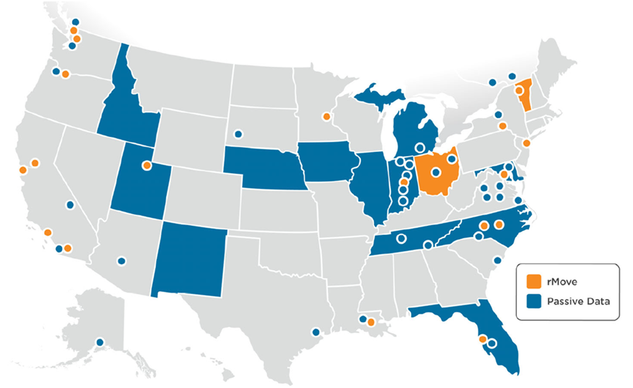
Mobile Data Experience
Over 50 projects in over 25 states

Slide 47
RSG’s Evolving Role
  Consulting
    RSG continues to offer consulting services to assist agencies with the expansion and application of third-party data sets
  Data Delivery
    RSG is now offering our own passive data products as rMerge
    Current and recent rMerge data clients include:
States
North Carolina
Illinois
Nebraska
Indiana (US 231)
California (District 9)
New Mexico
Tennessee
Metros
Charlotte
Nashville
Indianapolis
Tampa (FDOT D7)
Baton Rouge
Omaha

Slide 48






What is the data? Where does it come from?
GPS
+
WiFi beacons
=
Location-based services (LBS) for location-aware apps
}

Slide 49
What is ?
rMerge
  High-quality passive data products
  enriched and validated with traditional data and
  grounded in RSG’s deep expertise in travel behavior
Census
Traffic Counts
Travel Surveys
LBS data is reconciled, expanded, and validated against traditional data sources
LBS data
Big data from smartphone apps is the primary raw data source from which rMerge is derived

Slide 50
How Big is this Big Data?
  Raw data
  10-15% population on any given day (DAU)
  50% of population over a month (MAU)
  3.7 million devices in Tampa Bay region in April 2018
      Larger sample than surveys or pure navigational GPS
High quality, filtered data (Tampa)
  Many devices are only observed a few times, some are bad
  7% of population (+ visitors)
  353,466 total devices
  10.3 million trips (272k external trips)

Slide 51
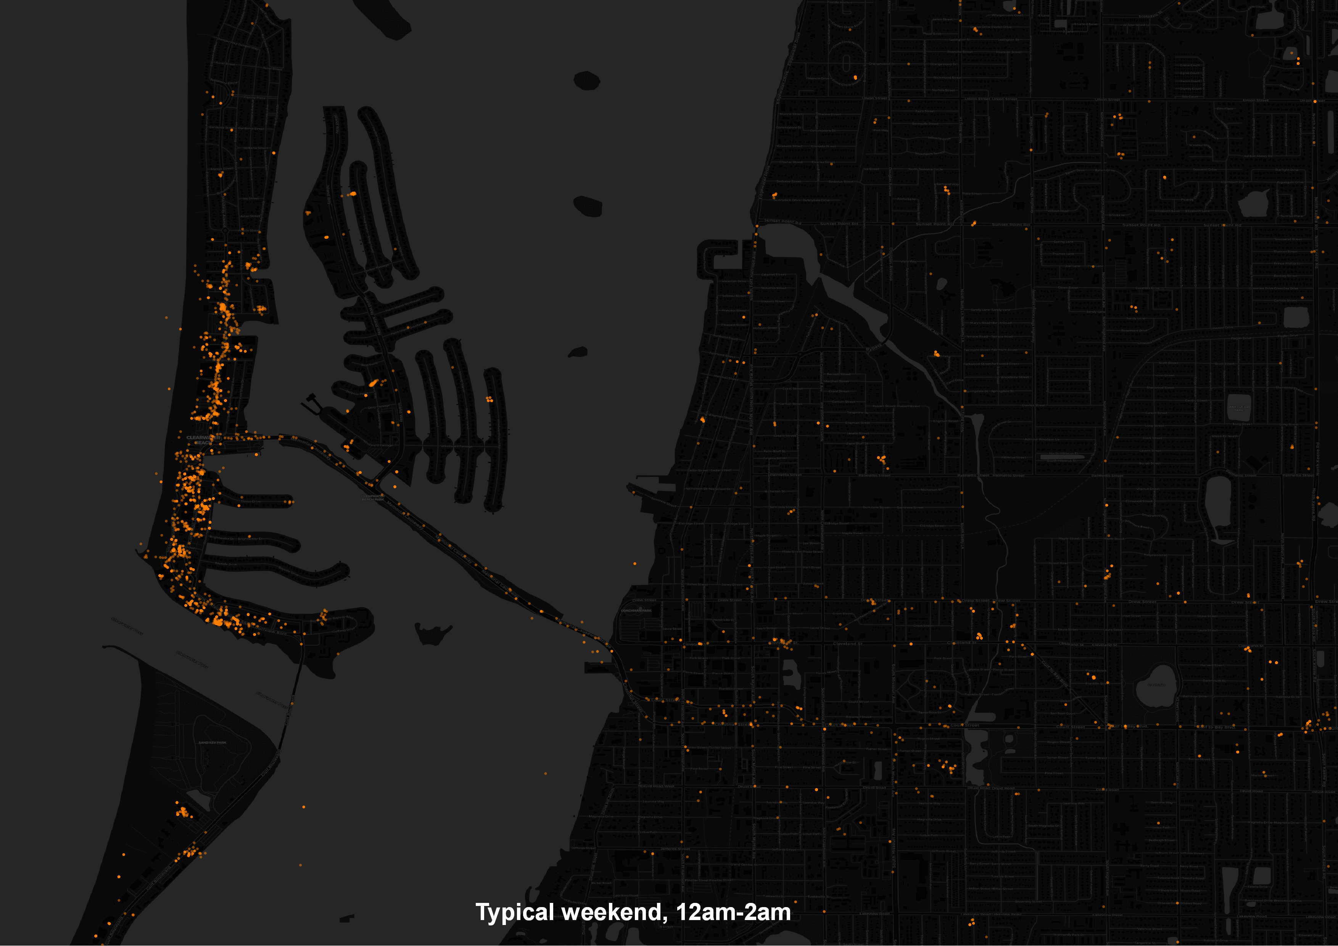
Clearwater Beach

Slide 52
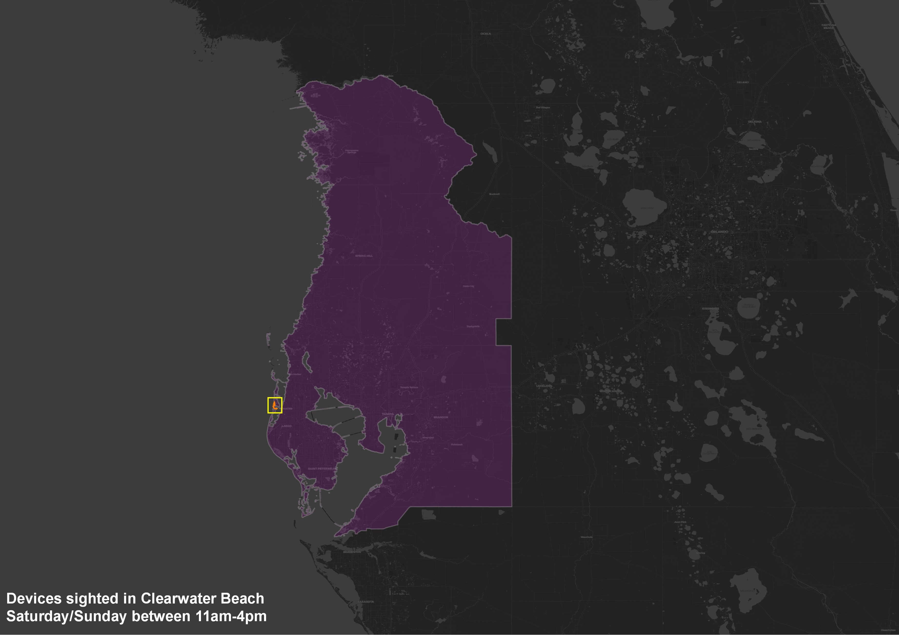

Slide 53

How is Privacy being Protected?
  Raw LBS data
  Only identifying information is “ad-id”
  RSG only uses ad-id to recruit into surveys and with consent to link surveys and big data for research
  RSG replaces ad-id before processing
Home & Work Locations
  Necessary for:
    Differentiating residents & visitors
    Identifying trip purpose (e.g., home-based work)
    Checking and correcting for demographic bias
  RSG never reports info below the zone
  RSG suppress/perturbs info for small zones
  Aggregation to OD matrices prevents reassociation of information with individuals using multiple anchor locations

Slide 54
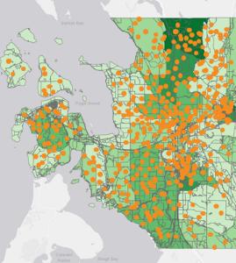
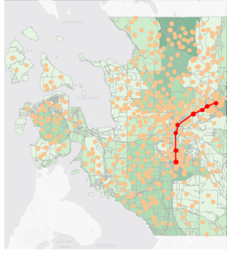
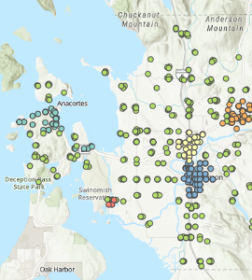
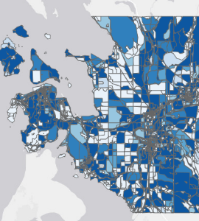
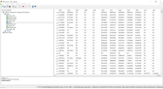
RSG’s 4-step process for passive OD tables
1
2
3
4
PREPARE INPUT DATA
IDENTIFY TRIPS
EXPAND TO REGION
AGGREGATE TO O-D
Device: #
Lat: 48.5xx
Lon: -122.5xx
Time: 1:23:45
Traffic Counts
Millions to billions of individual device location points from commercial LBS data* are extracted, evaluated for basic metrics & cleaned
Points are clustered to identify stop locations, locations are classified (home, work, other) and linked to create trips
Trips are expanded to region based on Census and traffic count data, surveys and other sources to provide representative O-D flows
Trip data aggregated to OD matrices, with key dimensions (such as time period, visitor / resident) broken out
* Typically represents 10-15% of population per day, or 50%+ for one month of observations

Slide 55
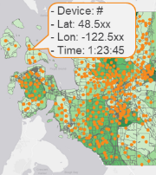
Raw LBS input data collected & cleaned
1
2
3
4
PREPARE INPUT DATA
IDENTIFY TRIPS
EXPAND TO REGION
AGGREGATE TO O-D
a
  Select study period and geography (shapefile)
  Intersect shapefile with national LBS data to extract devices
  with at least one ping* in region
EXTRACT PINGS
b
  Compute device level metrics on the extracted pings:
    Total and average daily distance and number of pings
    Number of unique coordinates, hours, and days
    Time between pings and maximum speed
COMPUTE METRICS
c
QUALITY FILTERS
  Remove bad devices & pings with noise reduction filters
    E.g. Speeds exceeding 500 mph, average time gap between pings exceed 5 days, monthly distance < 1 mile
  Refine thresholds based on deep exploratory analysis
* ping is a latitude/longitude coordinate with a timestamp registered by a device
* ping is a latitude/longitude coordinate with a timestamp registered by a device

Slide 56

Nebraska Data Sample
Data retrieved for October 2018
  Sightings 380,570,902
  Total devices 920,683
  Good devices 354,632
    Visitors oversampled, ~10% of residents
  Locations 2,517,224
  Trips 9,229,015

Slide 57
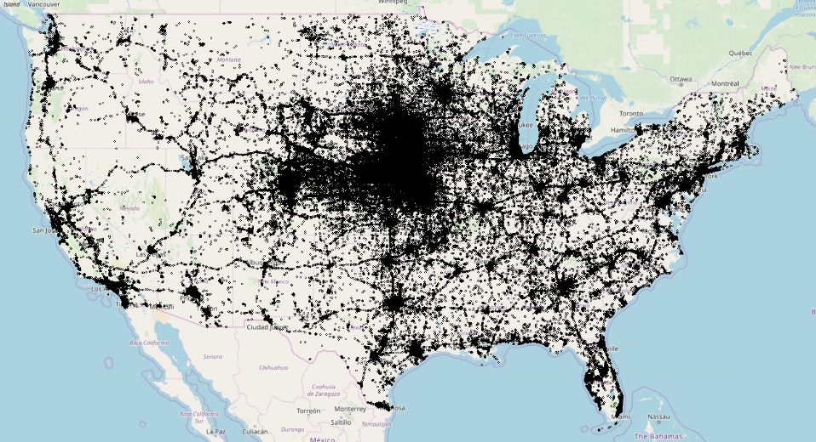
All Locations for Devices Observed in Nebraska

Slide 58

Trips identified based on “stop” locations
1
2
3
4
PREPARE INPUT DATA
IDENTIFY TRIPS
EXPAND TO REGION
AGGREGATE TO O-D
a
  Remove pings with poor horizonal accuracy (>100 meters)
  Cluster pings using density-based algorithm
  Tag clusters as stopped vs. moving based on rolling window speed
CLUSTER PINGS
b
  Classify stopped clusters as “home”, “work”, or “other”
    Based on recurring activity patterns, page-rank / node centrality metric, hours spent, and days seen at each cluster
CLASSIFY STOPS
c
BUILD TRIPS & QA/QC
  Create trips by connecting successive dwells (visits to a cluster)
  Tag time periods based on trip midpoint^{ˠ}
  Create plots, maps, and checks to validate trip output quality
* ping is a latitude/longitude coordinate with a timestamp registered by a device
ˠ midpoint by time – additional adjustments may be made for trips over 6 hours duration

Slide 59
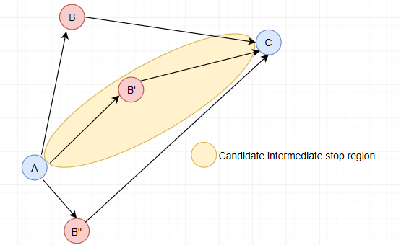
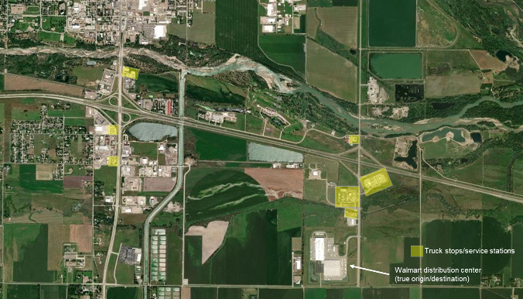
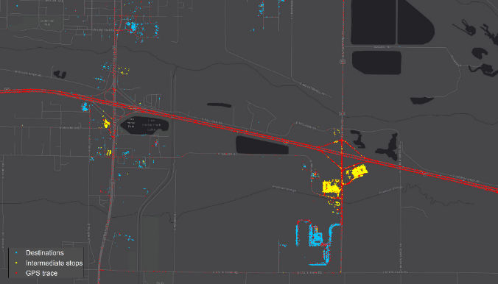
Filtering Intermediate Stops on Long Trips
Lack of diversion one distinguishing mark
Geofencing around gas stations / truck stops, etc.
Filtering stops for fuel, food, etc., necessary for understanding actual long-distance OD demand for both passenger and freight flows

Slide 60
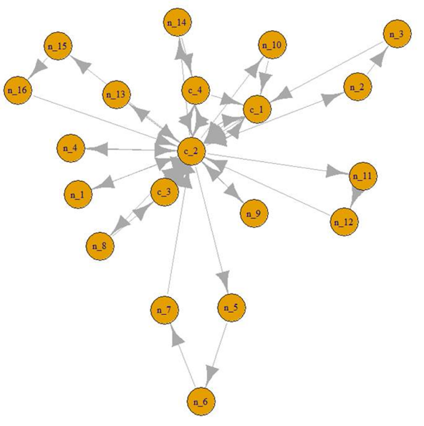
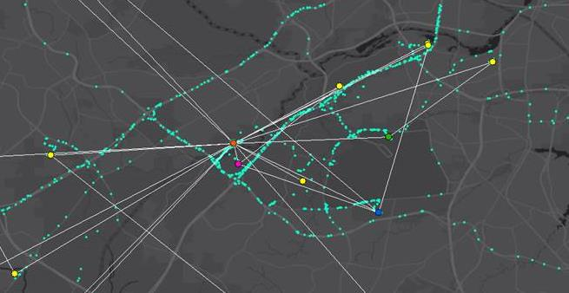
Graph Theory for Residence & Workplace Imputation – Critical for Fusion
Topological centrality as primary indicator, overnighting secondary – higher confidence, multi-point fusion
Supports resident / visitor market segmentation & data fusion

Slide 61
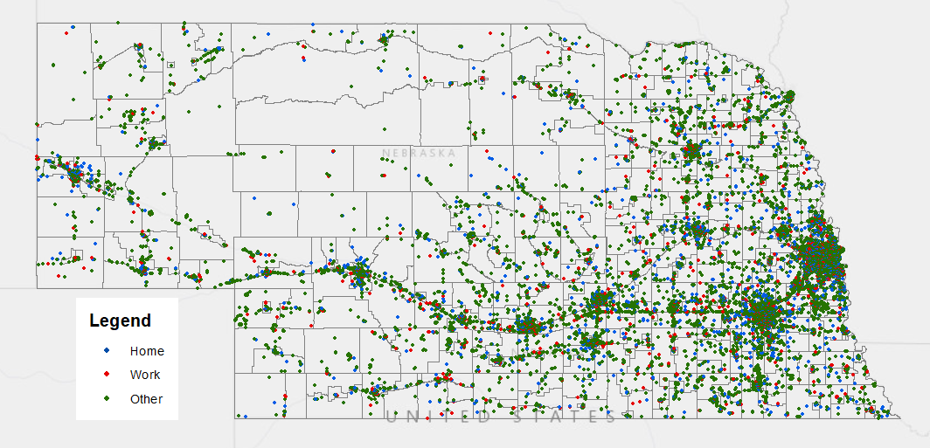
All Trip Ends

Slide 62
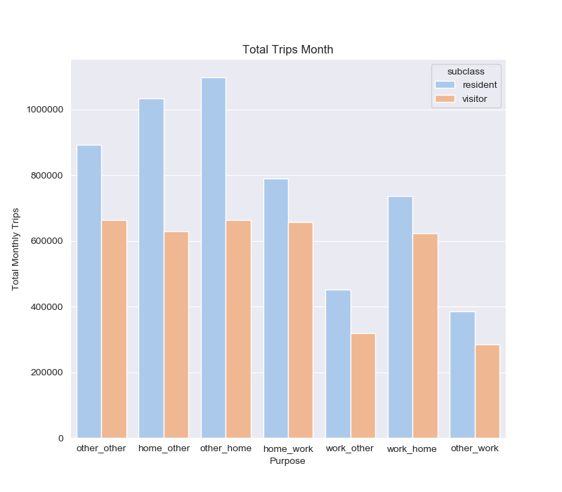
Trip Summary

Slide 63
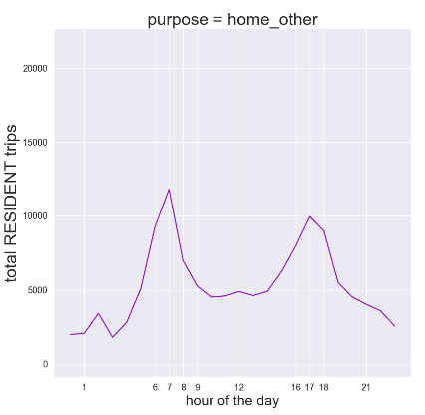
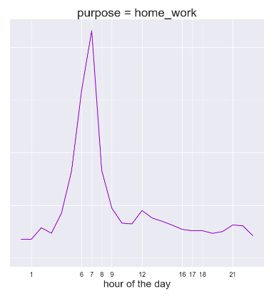
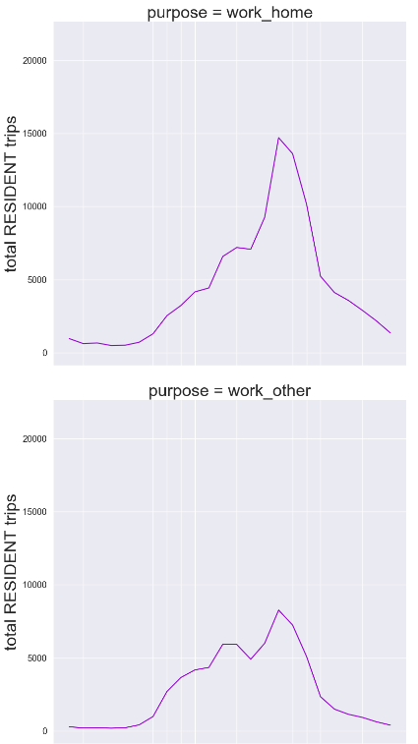
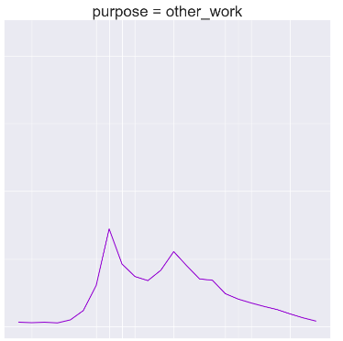
Hourly Trip Distribution

Slide 64
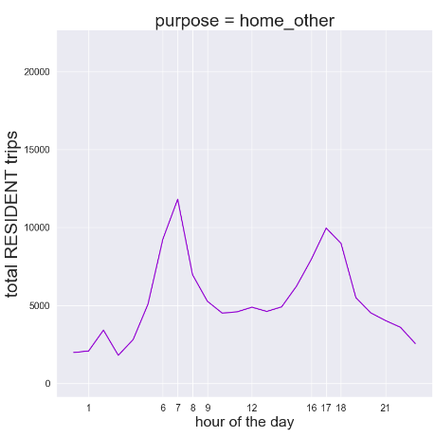
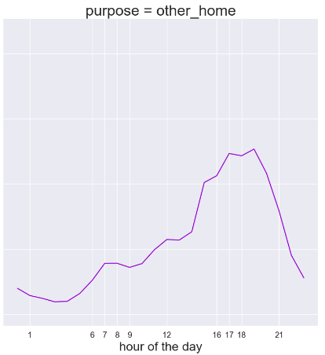
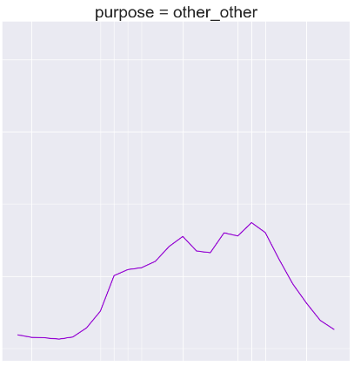
Hourly Trip Distribution

Slide 65
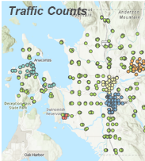
Expansion process matches regional counts and Census data
1
2
3
4
PREPARE INPUT DATA
IDENTIFY TRIPS
EXPAND TO REGION
AGGREGATE TO O-D
BIG DATA EXPANSION?
Big data are large scale observations.
But they are still only a sample of all travel.
And they are NOT a random sample.
Big data are known to have systematic biases.
But if we can measure bias, we can correct for it.

Slide 66
What’s Missing in Big Data?
?
  Travelers
    Seniors & low income populations
  Travel
    Geographic coverage
    Short activities & trips
    What else???

Slide 67
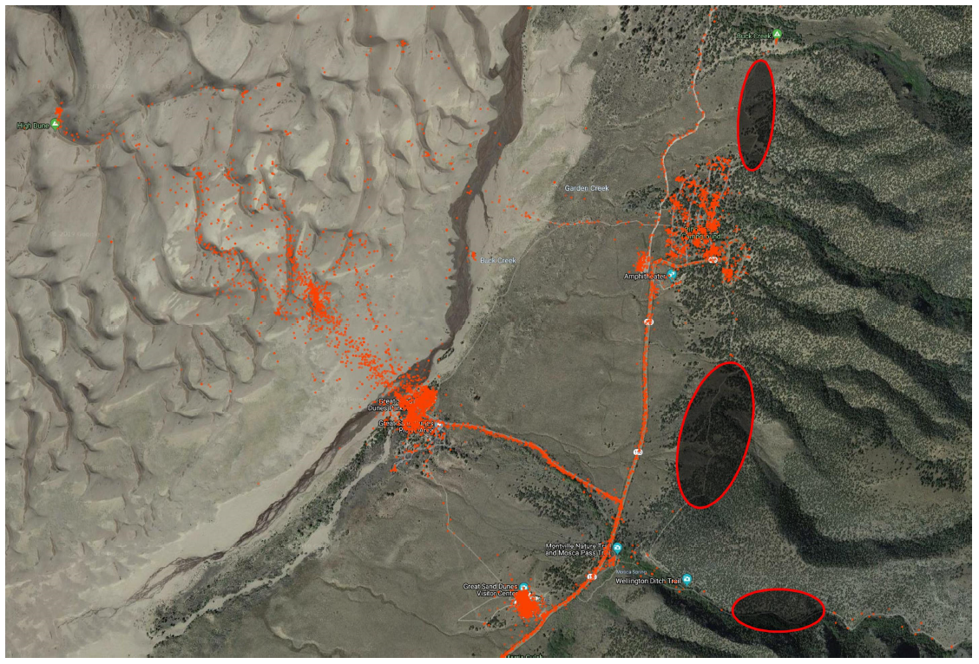
Geographic Coverage Gaps & Variations
SIGHTINGS AT GREAT SAND DUNES NATIONAL PARK IN JULY 2018

Slide 68
Data Verification: Demographics vs. Census
INCOME
LBS
Census
AGE
LBS
Census

Slide 69

Data Verification: Duration vs. Smartphone Survey

Slide 70
Expansion process matches regional counts and Census data
1
2
3
4
PREPARE INPUT DATA
IDENTIFY TRIPS
EXPAND TO REGION
AGGREGATE TO O-D
a
  Rake number of residents and workers to Census estimates
RAKING TO CENSUS
PARAMETRIC SCALING
b
  Create initial expansion factor using simple scaling to counts
  Apply expansion factor function (of trip/activity length)
c
RAKING TO COUNTS
  Refine expansion factors with Iterative Screenline Fitting algorithm, a special form of raking or IPF
LIMITED MATRIX ESTIMATION
d
  Apply Matrix Estimation (ODME) algorithm
    Non-parametric expansion factors from comparison of loaded volumes from assignment to observed counts
    Minimum and maximum imposed on expansion factors

Slide 71

Screenlines for LBS Expansion

Slide 72

Data aggregated to create OD tables
1
2
3
4
PREPARE INPUT DATA
IDENTIFY TRIPS
EXPAND TO REGION
AGGREGATE TO O-D
a
  Bin trips by resident and non-resident status
    Calculated in trip-identification step from device “home” location
  Bin based on trip time period
CLASSIFY TRIPS
b
  Aggregate origins and destinations to model TAZ structure (or other designated geographies) to complete matrices
AGGREGATE TO MATRIX

Slide 73

Expanded Flows
Dynamic Chord Visualization (github.io)

Slide 74
Alternative Long-Distance Passenger Model

Slide 75
Alternative Long-Distance Passenger Model
Create 2018 National Model scenario
Implement new simpler passenger long-distance and visitor model similar to the models developed for Michigan and Illinois.
Allow user to toggle between national long-distance model and alternative long-distance model to support ensemble forecasting

Slide 76
Passenger Demand Models
Short Distance
  < 50 miles and near home
  State + Halo residents only
Long Distance
  > 50 miles and one end near home
  4 purposes for State + Halo residents
  Single purpose for Rest of USA residents
  Separate Auto and Airport Ground Access
Visitor
  Both ends away from home
  Linked to long-distance model
  Single purpose

Slide 77
Michigan Framework
Model linkage (HB -> NHB & Long-Distance -> Visitor)
Long-Distance Trips
Visitor Trips
Trip Generation
Destination Choice
Trip Generation
Greater Michigan
Greater Michigan
Other
Other
Destination Choice

Slide 78

Visitor vs. Long-Distance Trips
Good Correlation
Not all visitor travel explained by long-distance
*AirSage Zones in MI excluding DTW

Slide 79
Model Calibration & Validation

Slide 80
TSM3 Validation Statistics
One of the best statewide model base year validations in the country
Model far exceeds standards except ADT < 5k
RMSE slightly better than TSTM2 except ADT < 5k

Slide 81
TSM3 Validation Statistics
Urban area statistics overall reasonable even by TN MPO model standards for RMSE by functional class, but lower class roads don’t perform as well

Slide 82

TSM3 Validation Statistics
Correlation = 0.97

Slide 83

TSM3 Validation Statistics
Correlation = 0.94

Slide 84

TSM3 Transit Ridership Validation

Slide 85
TNC & CAV Framework

Slide 86
TNC & CAV Framework
Implement framework developed for Michigan and also being implemented for Illinois
Develop set of assumptions for a scenario with SAE Level 3/4 full autonomy on freeways only

Slide 87
“All models are wrong, but some are useful.”
– George Box, famous statistician

Slide 88
How can models be USEFUL in planning for CAVs?
Scenario Planning
  structured way for organizations to think about the future using a limited number of scenarios (e.g., best case, worst case, most likely, etc.)
Exploratory Modeling Analysis (EMA)
  simultaneously vary input assumptions across a wide range of future scenarios along key dimensions of uncertainty
  to explore potential outcomes, find critical input assumptions, and identify future policy directions likely to be robust in the face of “deep uncertainty”

Slide 89

CAVs in Trip-Based Models
Lots of off-model / manual analysis
Michigan, Illinois statewide models
New factors / market segments + ZOV step

Slide 90
CAVs in Trip-Based
MPO Models
RESIDENT INTERNAL PASSENGER TRIPS
EXTERNAL AND
TRUCK TRIPS
AUTO OWNERSHIP
Overall Ownership Level
Split of Vehicles between CAV vs. Conventional
Lots of off-model / manual analysis
Adapted Michigan framework
Charleston, Charlottesville, & Ann Arbor MPOs
INDUCED TRIPS
Adjust Trip Rates by Seniors, Children, Autos
INDUCED TRIPS
EE & EI/IE Scaling Factors
SUT Scaling Factor
MUT Scaling Factor
DESTINATION CHOICE
Adjust Trip Lengths by CAV ownership
MODE CHOICE
Add MaaS modes
Add CAV / Conv. Submodes
TIME OF DAY
Ext Diurnal Distributions
Trk Diurnal Distributions
ZOV GENERATION
HH CAV to Family
HH CAV to Home
HH CAV to Free Parking
HH CAV to Circulate
MaaS CAV to Next Pickup
MaaS CAV to Depot
ASSIGNMENT
Autonomous Vehicle Only Lanes / Facilities
Passenger Car Equivalencies for
Autonomous Cars and Trucks in Mixed Traffic

Slide 91

Generation & Mode Shares

Slide 92

Trip Generation
Scale up trips
to represent
induced demand
Largest increases to households with:
  Disabled
  Seniors
  Children
More long distance / external trips from
reduced lodging cost?
[Also, careful of trip rates by vehicle ownership]
Source: Jalopnik.com

Slide 93

Mode Choice
Add MaaS mode & CAV / Conventional submodes
Can assert mode shares for different scenarios
Can vary occupancy of sCAVs
Person Trips
Private SOV
Private HOV
MaaS
Transit
Active
CAV
Cnv
CAV
Cnv
CAV
Cnv
Notes:
This slide is more for MPO models

Slide 94

Passenger Destinations

Slide 95

Trip Distribution
Passengers may be willing to travel farther since time in CAVs can be used positively for working, relaxing, sleeping, etc.
User can factor down traveler sensitivity to travel time / impedance

Slide 96

Long-Distance Time-of-Day

Slide 97

Time-of-Day
Long distance travelers may use sleeping hours to travel
Trucks /
long distance travelers may shift to nighttime hours to avoid congestion
Source: theautofuture.com

Slide 98

ZOV Modeling

Slide 99

Deadheading / ZOVs
Six Types of ZOV trips
  Private CAVs
    for car sharing among
    household members (1)
    to avoid paid parking
      by parking at home (2)
      by parking elsewhere (3)
      by circulating instead of parking (4)
  Shared CAVs
    for passenger pick-up/drop-off (5)
    to/from depots (6)
    (for re-charging / demand response)
Source: driverlesstransportation.com

Slide 100
Private CAV ZOV Modeling Methods
for car sharing among household members
  invert asserted percentage of Os & Ds, gravity model
to avoid paid parking by parking at home
  invert asserted percentage of HB trip ODs for pay TAZs
to avoid paid parking by parking elsewhere
  create trips between pay TAZ & nearest non-pay TAZs as a function of long Ds at pay TAZ
to avoid paid parking by circulating
  estimate VMT per parking zone, divide by length of non-freeway links within buffer of TAZ use volume as preload on those links

Slide 101
Shared CAV ZOV Modeling Methods
for passenger pick-up/drop-off
  invert all passenger Os & Ds; gravity model
to/from depots (for re-charging / demand response)
  assert depot TAZs with capacities; generate trips by min(difference in demand between periods, charging requirement assumption); gravity between shared CAV Os & Ds and depot TAZ

Slide 102

Assignment

Slide 103

Assignment
Separate autonomous and conventional vehicle classes
User option to have dedicated CAV-only facilities/lanes and assert high capacities and higher speeds
User option to
assert different
capacity consumption
in mixed traffic
(through PCE factor)

Slide 104
Parting Thoughts
Models can be enhanced to capture almost (but not) all dimensions of uncertainty about CAVs
  Add adjustments to all steps
  Add taxi/TNC mode
  Add special ZOV components
They can NOT tell us what will happen
They CAN help us understand
  the range of possible futures
  the relative importance of different factors
  the robustness of policies / investments

Slide 105
Contact
Vince Bernardin, Jr, PhD
DIRECTOR OF TRAVEL FORECASTING
Vince.Bernardin@rsginc.com
812.200.2351
www.rsginc.com
Steven Trevino
CONSULTANT
Steven.Trevino@rsginc.com
812.200.2352

