Slide 1
Back to the Future
GNRC’s Application of UrbanSim
February 26, 2020 TNMUG Meeting

Slide 2
UrbanSim Overview and Applications
Daniel Jerrett, PhD Chief Economist, UrbanSim Inc.

Slide 3
UrbanCanvas Modeler
UrbanSim Models on the Cloud

Slide 4
URBANSIM MODEL SYSTEM
Open source model system to project the outcomes of city and metropolitan housing, land use, transportation and environmental plans and policies
Initial development funded by over $20M in six grants from NSF and other federal agencies, now broadly supported by users, including CMHC
Has become the most widely used land use model system by Metropolitan Planning Organizations (MPOs)
Now being used on 5 continents.

Slide 5
UrbanSim
Households
Governments
Businesses
Demographic Processes
Land Use Regulation
Economic Processes
Aging
Household structure
Migration
Land use plans
Growth management
Economic structure
Output goods/services
Inter-regional trade
Long-term Choices
Transportation
Long-term Choices
Residential Mobility
Housing Choice
Labor supply
Workplace Choice
Vehicle Ownership
Infrastructure
Pricing
Mobility
Location Choice
Labor Demand
Developers
Short-term Choices
Real Estate Processes
Short-term Choices
Activity Generation
Activity Location
Mode Choice
Route Choice
Land development
Housing development
Non-res development
Redevelopment
Economic structure
Output goods/services
Inter-regional trade

Slide 6
UrbanSim RUNS A SEQUENCE OF MODELS IN ANNUAL ITERATIONS
1
Real Estate Price Model
OLS Regression
2
Household Transition/Relocation
3
Household Location Choice
4
Job Transition/Relocation
Multinomial Logit
Job Location Choice
5
Real Estate Development Model
6

Slide 7
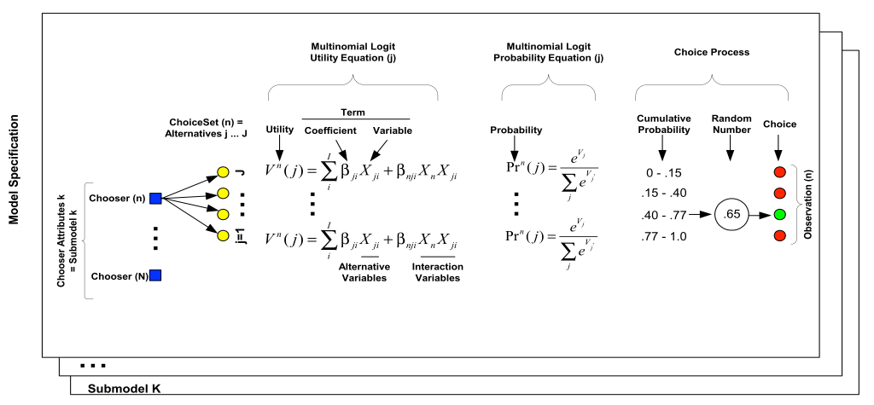
URBANSIM IMPLEMENTED AS MICROSIMULATION, OR AGENT-BASED MODELS
Simulating individual choices such as household location, for entire populations, at an agent level.

Slide 8
URBANSIM THEORETICAL FOUNDATIONS
Random Utility Theory (McFadden)
Theoretical basis for discrete choice models (such as mode choice): agents choose among alternatives based on the relative utility of the available options Multinomial and nested logit models, more general forms relaxing the IIA property
Urban Economics/Bid Rent Theory (Alonso, Mills, Muth)
Explains land use outcomes: density, rents, as outcome of bidding process based on willingness to pay for locational amenities: trade-off travel time vs housing cost
Hedonic Price Theory (Rosen)
Observed prices of composite goods like housing can be ‘decomposed’ to the implicit prices of their attributes; widely used to measure the market valuation of locational amenities or disamenities

Slide 9
URBANSIM THEORETICAL FOUNDATIONS
Dynamic Market Equilibrium, Price Adjustment, Disequilibrium
Markets are rarely in equilibrium; especially real estate due to supply lags and high transactions costs; information is imperfect; speculation can lead to bubbles
Current housing market crisis is an excellent example of market disequilibrium
Microsimulation (Orcutt)
Initially a computational framework to explore individual level impacts of policies; later found more computationally efficient than complex aggregate models
Strong empirical support for microsimulation to avoid aggregation bias and ecological fallacy (attributing to individuals behavior from aggregate patterns)
Geographic Information Systems and Spatial Analysis (Tobler, Anselin)
Radical advance in spatial analysis capabilities;
Representation of walking scale accessibility

Slide 10
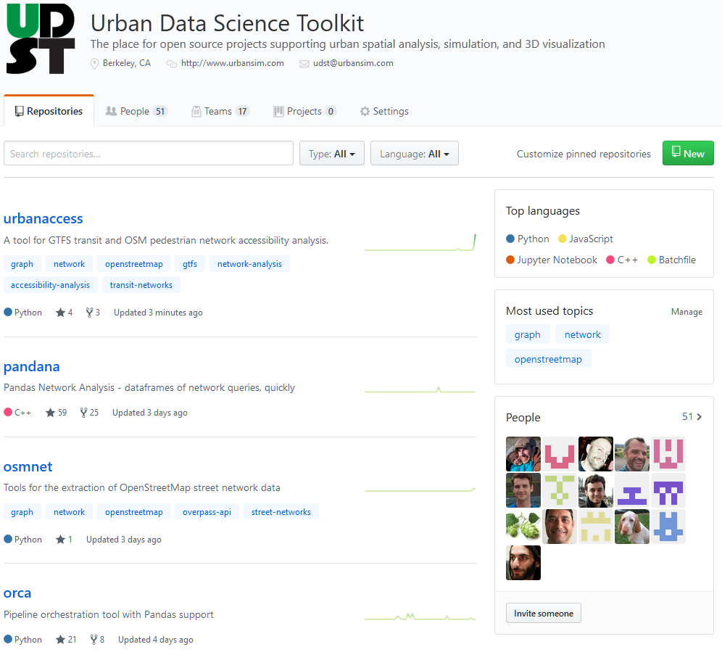
URBANSIM SOFTWARE: OPEN SOURCE URBAN DATA SCIENCE TOOLKIT
URBAN DATA SCIENCE TOOLKIT:
URBANSIM
A platform for simulating urban real estate markets and their interaction with transportation.
ORCA
A generalized framework for data processing and orchestration to support UrbanSim, ActivitySim, and other types of modeling.
ACTIVITYSIM
A platform for simulating Activity-Based Travel.
URBANACCESS
A library to obtain, clean, merge and analyze GTFS Transit Networks
and OSM networks for pedestrian and transit accessibility.
SPANDEX
Spatial Analysis and Data
Extraction.
SYNTHPOP
A Population Synthesizer.
CHOICEMODELS
A library of flexible discrete choice models, including Multinomial
Logit, Nested Logit, Mixed Logit, and Latent Class Models.
PANDANA
A fast network accessibility engine for computing accessibility metrics.

Slide 11
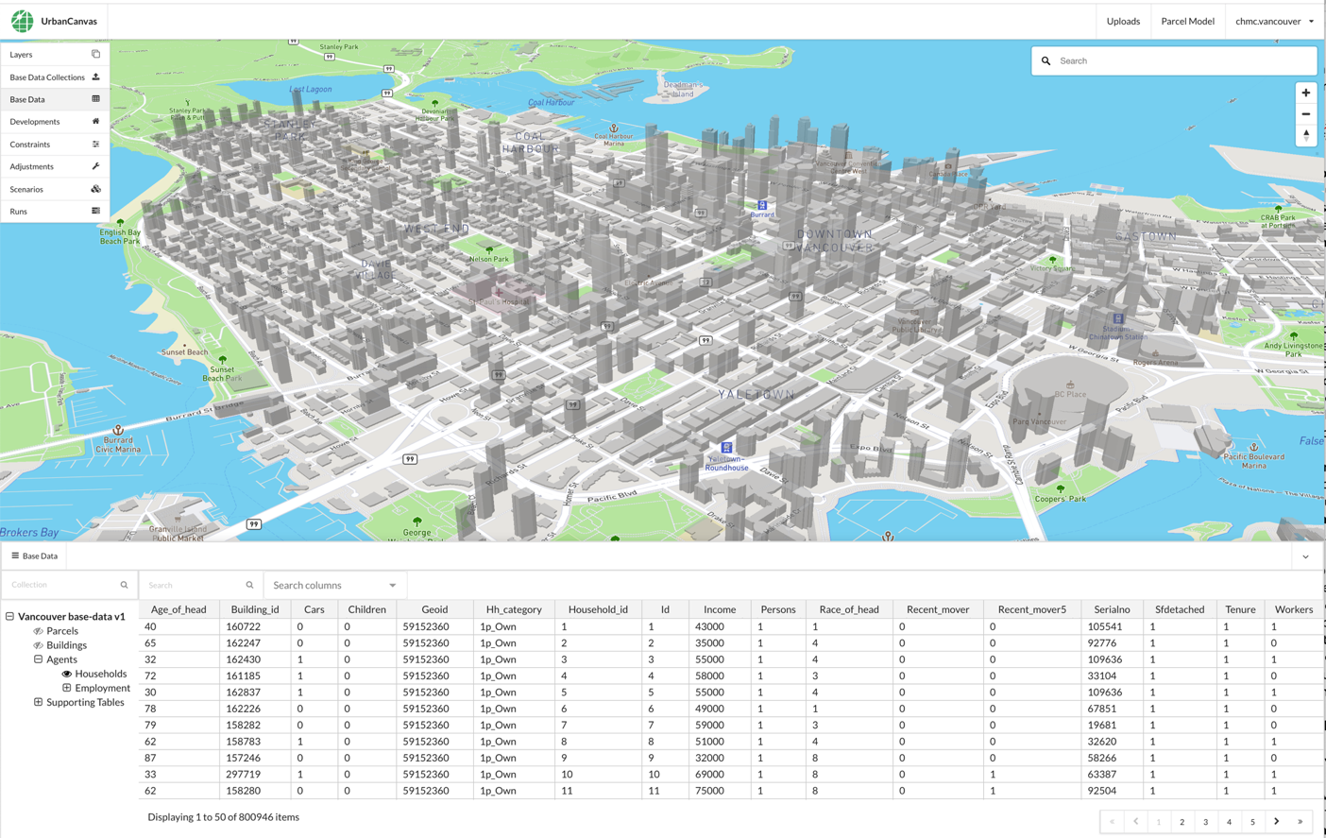
URBANSIM CLOUD PLATFORM

Slide 12
URBANSIM CLOUD PLATFORM
DESIGN
SIMULATE
VISUALIZE
Design scenarios based on existing and proposed policies interactively and visually to simulate variations of land use and transportation plans. These scenarios can be compared across various attributes to allow regional planners to make calculated and informed decisions.
Stimulate the regional real estate market at the level of individual decision-makers such as households, employers, and real estate developers. Urbansim runs on the cloud, for one or many scenarios, and rapidly
generates results.
Use a large and flexible portfolio of indicators to gain insight into existing conditions and the effects of alternative scenarios. Visualize existing conditions and Indicators in a dynamic 3D web mapping environment, and invite users to review result, or share
them with the public.

Slide 13
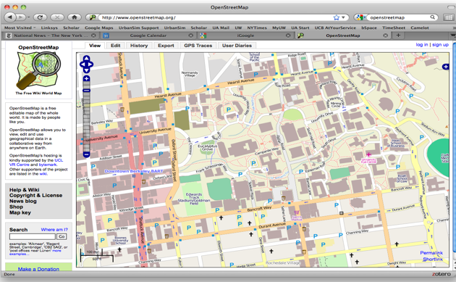
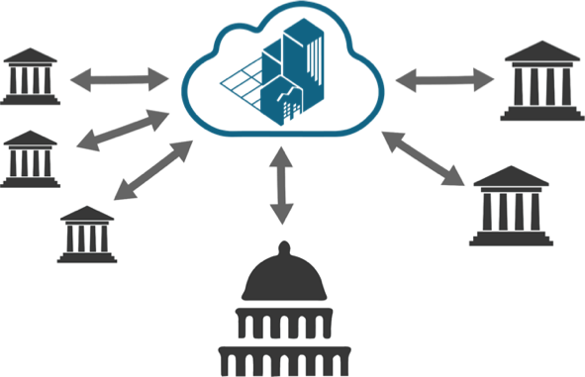
OPEN DATA FOR PLANNING
Parcel
Building
Zoning
Development Projects
Parcel Boundaries
Zoning/Land use
Number of Stories
Parcel Identifier
Footprint Geometry
Structure Type
Types
Setbacks
Density
Allowed uses
Geometry or Associated Parcels
Non residential Square footage
Use/Structure Type
Open Street Map
UrbanCanvas

Slide 14
A TYPICAL SEQUENCE OF URBANSIM FORECASTING STEPS
1
Incorporate external macroeconomic forecast
2
Incorporate development pipeline information
Incorporate local planning knowledge
3
Incorporate development constraints
4
Incorporate model adjustments (sparingly)
Member Jurisdiction Reviews
5
Evaluate simulation results
6
Develop baseline scenario
7
Develop alternative scenarios
8
Gather feedback, and then iterate

Slide 15
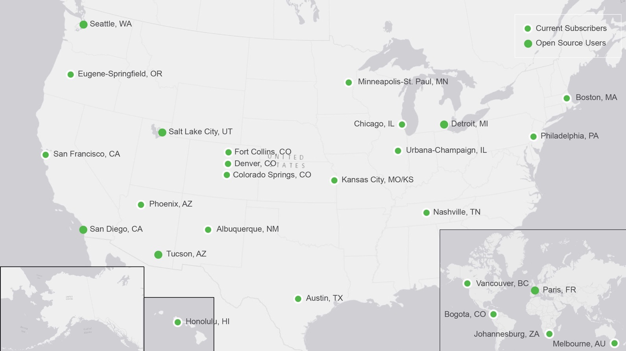
OUR CUSTOMERS
Hill Valley

Slide 16
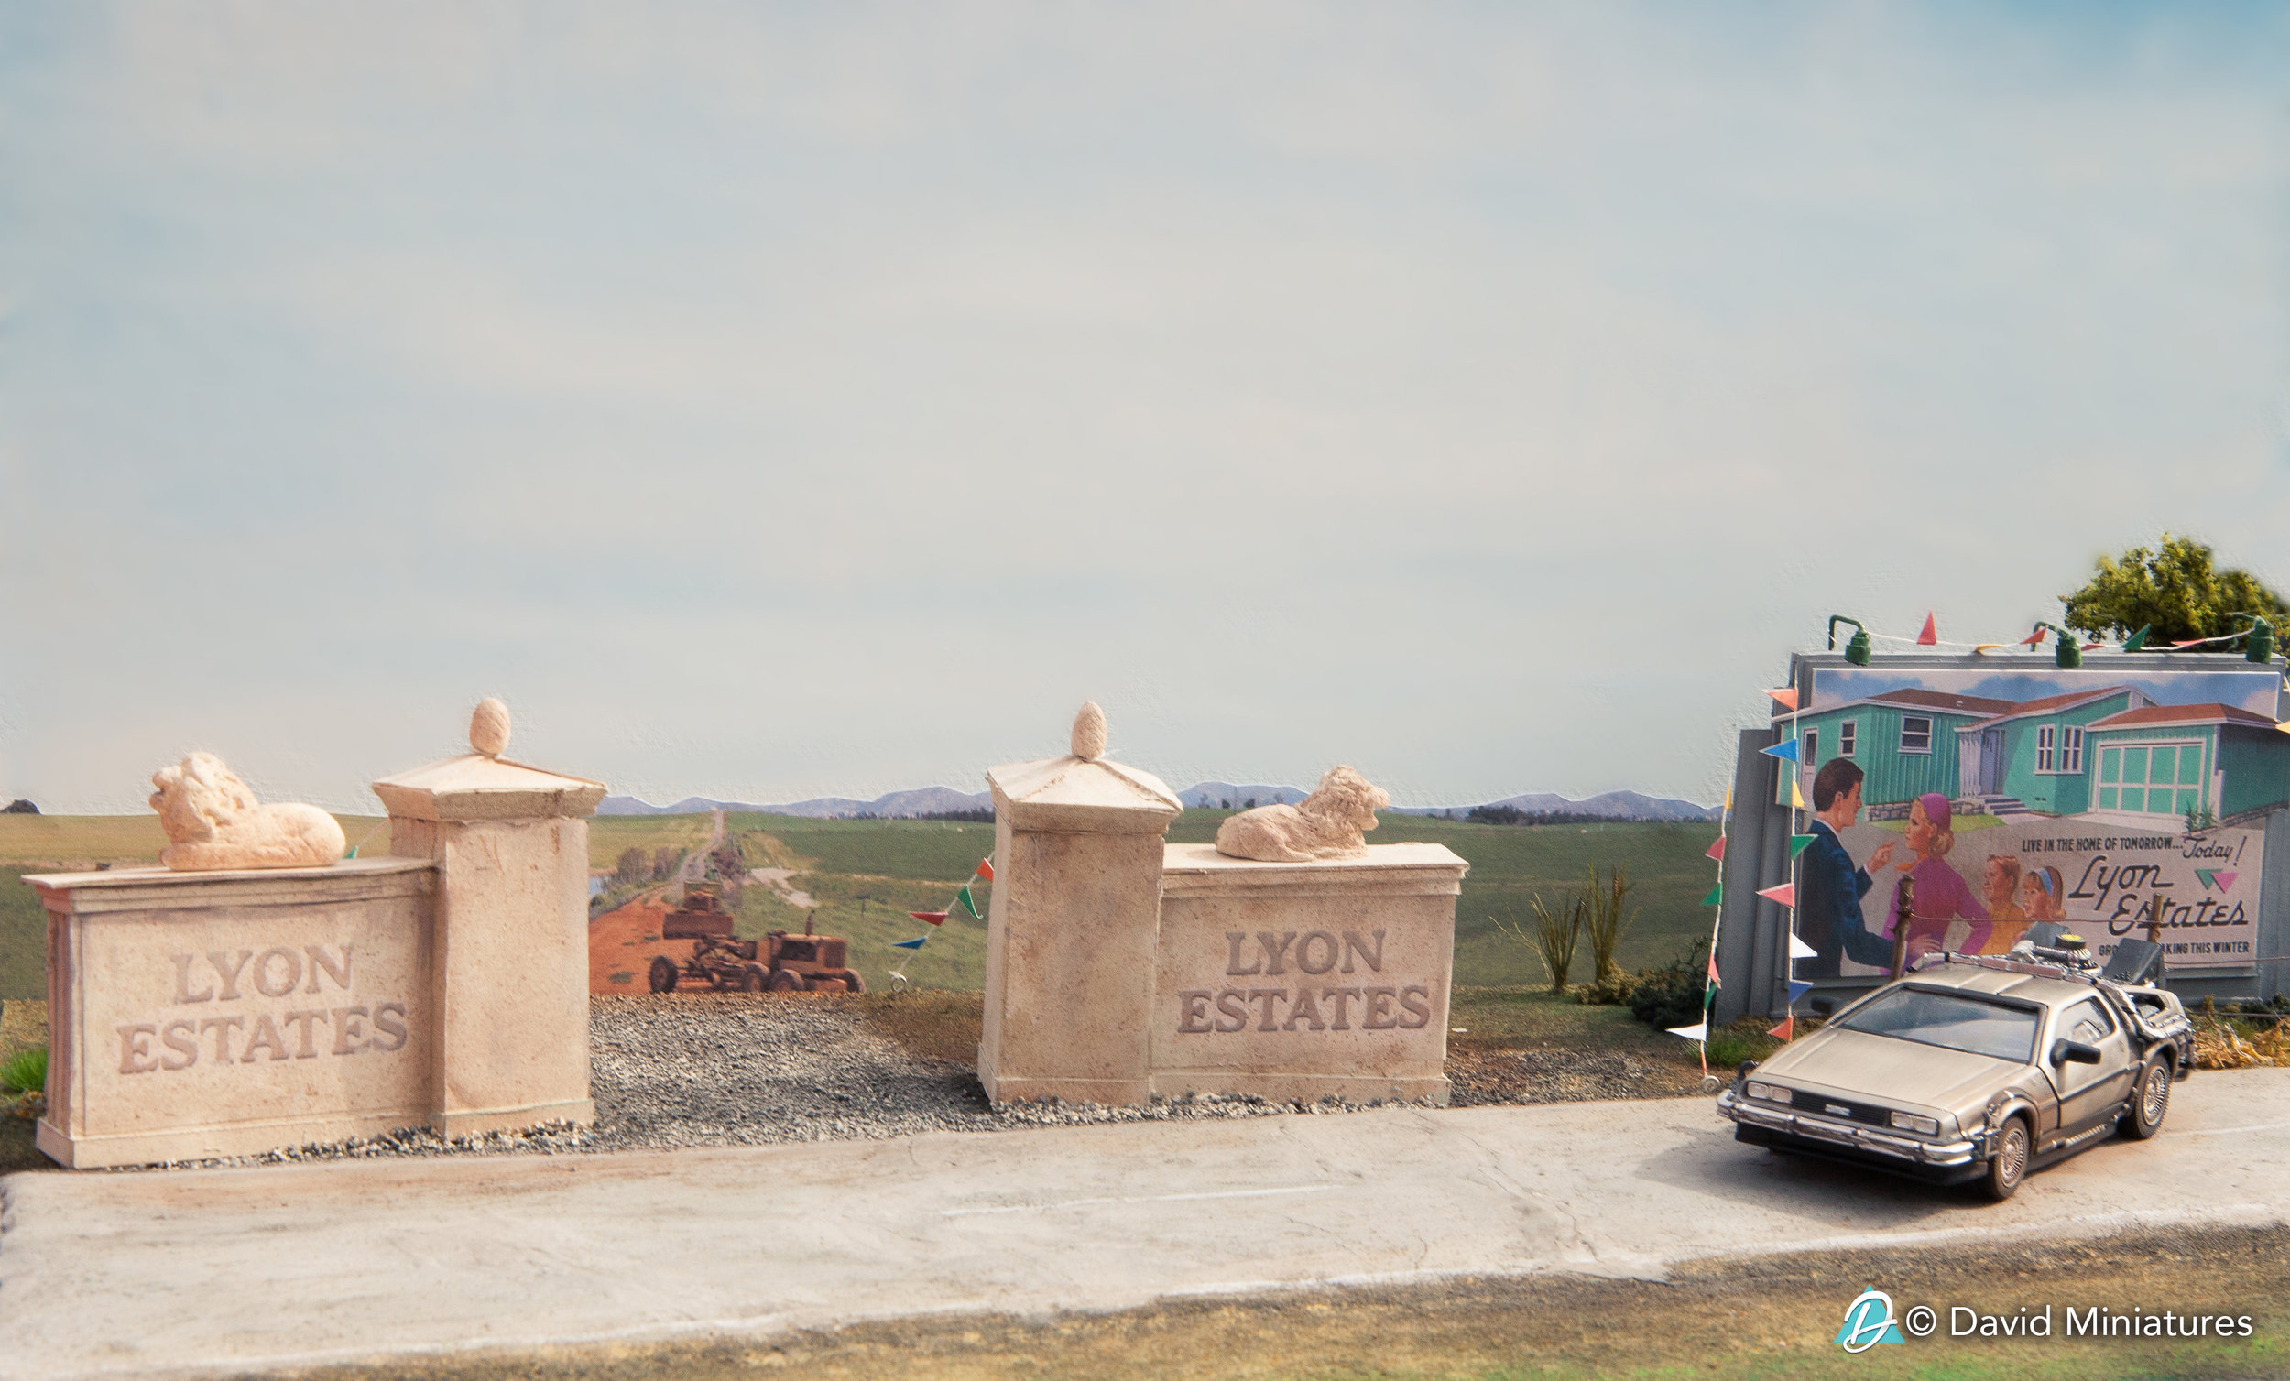
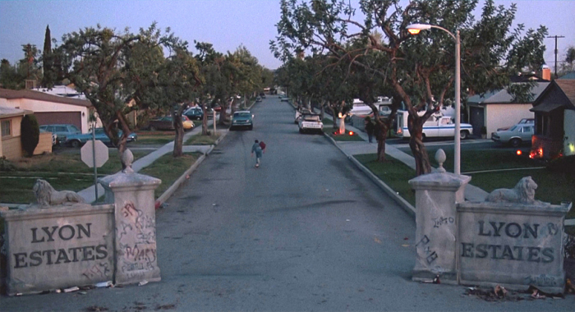
Hill Valley Example

Slide 17
Implementation Experience
Max Baker Director of Research and Analytics, GNRC

Slide 18
Project FAQs
How long will this take?
Typically nine months to one year
How many staff are needed?
We have used three FTE
Parcel or area based?
Depends on needs and time
Why are you doing this?

Slide 19
Population
GNRC projects 3.2 million people by 2045

Slide 20
Employment
GNRC projects 2.1 million jobs by 2045

Slide 21
Disaggregation
Why do we disaggregate to the parcel?
Known parcel and structure information
Provides greater confidence in aggregation to TAZ
Control for specific scenarios (e.g. policy shift in zoning)
How do we disaggregate to the parcel?
Land use allocation models
Previously this was done using ULAM and CommunityViz
Currently updating to UrbanSim platform

Slide 22
CommunityViz
Parcel based land use allocation model
Used since 2008
Superseded ULAM (2004-2006)
RTPs (2035 & 2040)
Subarea Studies (Tri-County, Northeast, Southwest, Southeast, NashvilleNext)
ArcGIS extension
Limited to model runs of one county at a time (over a week of processing time)
Required separate supply/suitability and allocation models
Off-model postprocessing of MOEs
Manual redevelopment
No feedback loop with transportation
Forecast population and employment growth only, not existing
Based on future land use policy and character areas

Slide 23
UrbanSim
Why are we switching to UrbanSim for 2045 RTP?
Used and vetted by respectable regional agencies
UrbanCanvas Modeler Cloud Platform is sub-parcel based
Can run entire region simultaneously (< day)
Integrated submodule, including redevelopment
Feedback loop with travel demand
Ability to integrate indicators

Slide 24
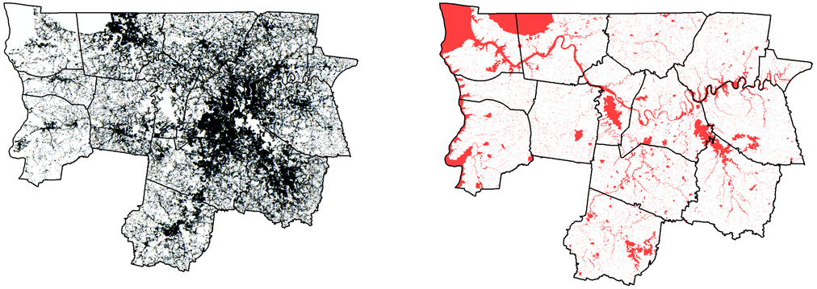
UrbanSim – Inputs
What is required to run UrbanSim?
Parcel Level
Geography and acreage
Land use
Zoning
Land value
Undevelopable land
Structure Level
Structure type
Number of housing units
Nonresidential square footage
Year built
Improvement value
Forecasts (2018 to 2045)
Households
Employment by sector

Slide 25
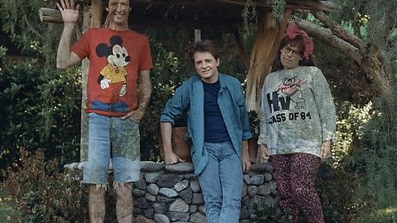
UrbanSim – Process and Needs
What is the build process and what issues have we had?
Data collection and cleaning
Forecasts
Tax Assessor Data
Inconsistencies in definitions
Parcel topology
Lack of information on untaxed property
Zoning and Building Types
Employment Data
Developmental Constraints
Pipeline development
Issues
Using different population synthesizer (ABM uses PopSyn)
Estimation and imputation of people into buildings

Slide 26
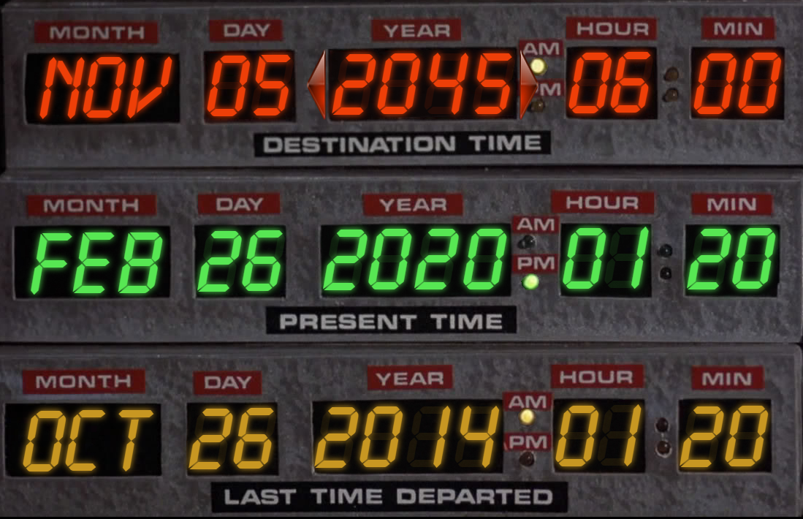
UrbanSim - Outputs
What’s Next?
Base Year Estimation
Travel Demand Model
Other modeling tools (Latent demand, impervious surface, tree canopy)
Sub- Block Group distribution
Stakeholder Review
Minor shifts between parcels
Verify pipeline development
Future Year Estimation
Travel Demand Model
Other modeling tools
Small area forecasts

Slide 27
UrbanSim - Outputs
What else does UrbanSim provide?
Land and Development
Housing units by type, density, price, occupancy
Non-residential buildings by type, density, price
Acreage of agricultural land, forest, open space
Demographics
Households by income, size, life cycle
Economics
Employment by sector and building type
Transportation
Accessibility, Mode Shares, Vehicle Miles Traveled, Congestion Delay
Environment
Greenhouse Gas (GHG) Emissions, Air Pollution, Energy Use, Water Use
“Great Scott!”

Slide 28
UrbanSim Application Example
Daniel Jerrett, PhD Chief Economist, UrbanSim Inc.

Slide 29
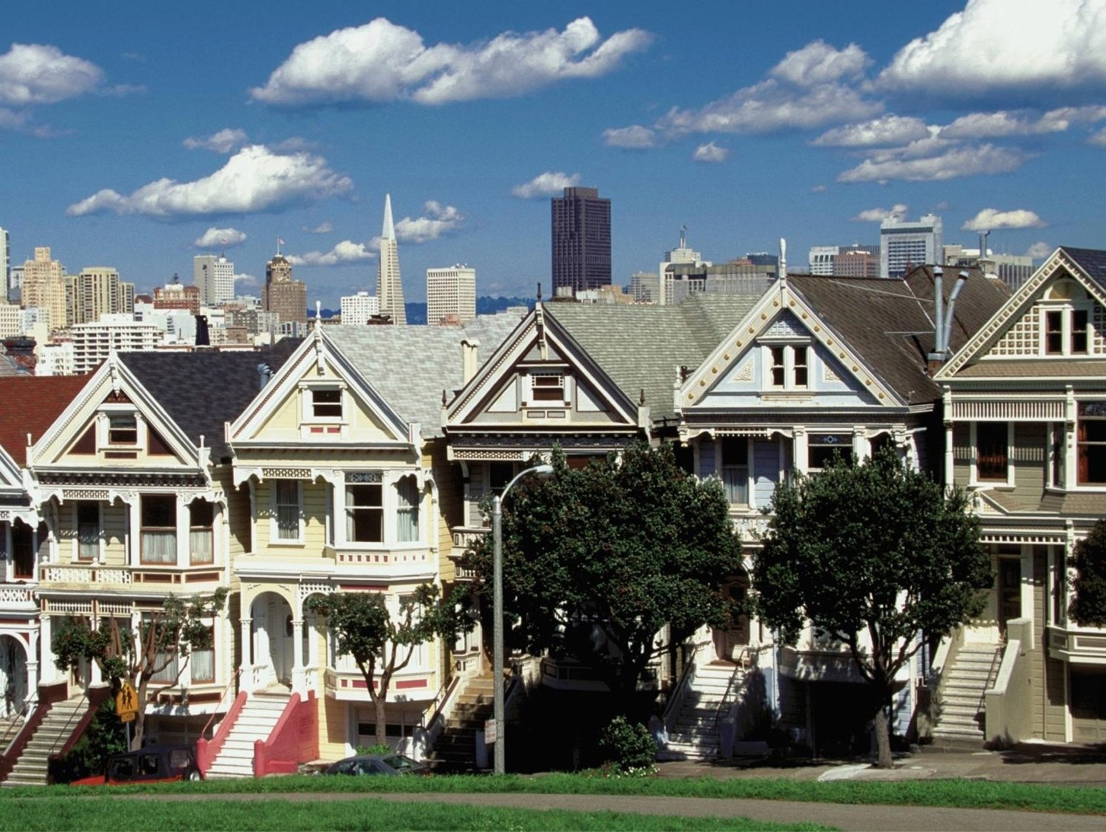
URBANSIM APPLICATION EXAMPLE
First regional plan to integrate transportation, land use, and housing
(Sustainable Communities Strategy)
Initiated by California Senate Bill 375

Slide 30
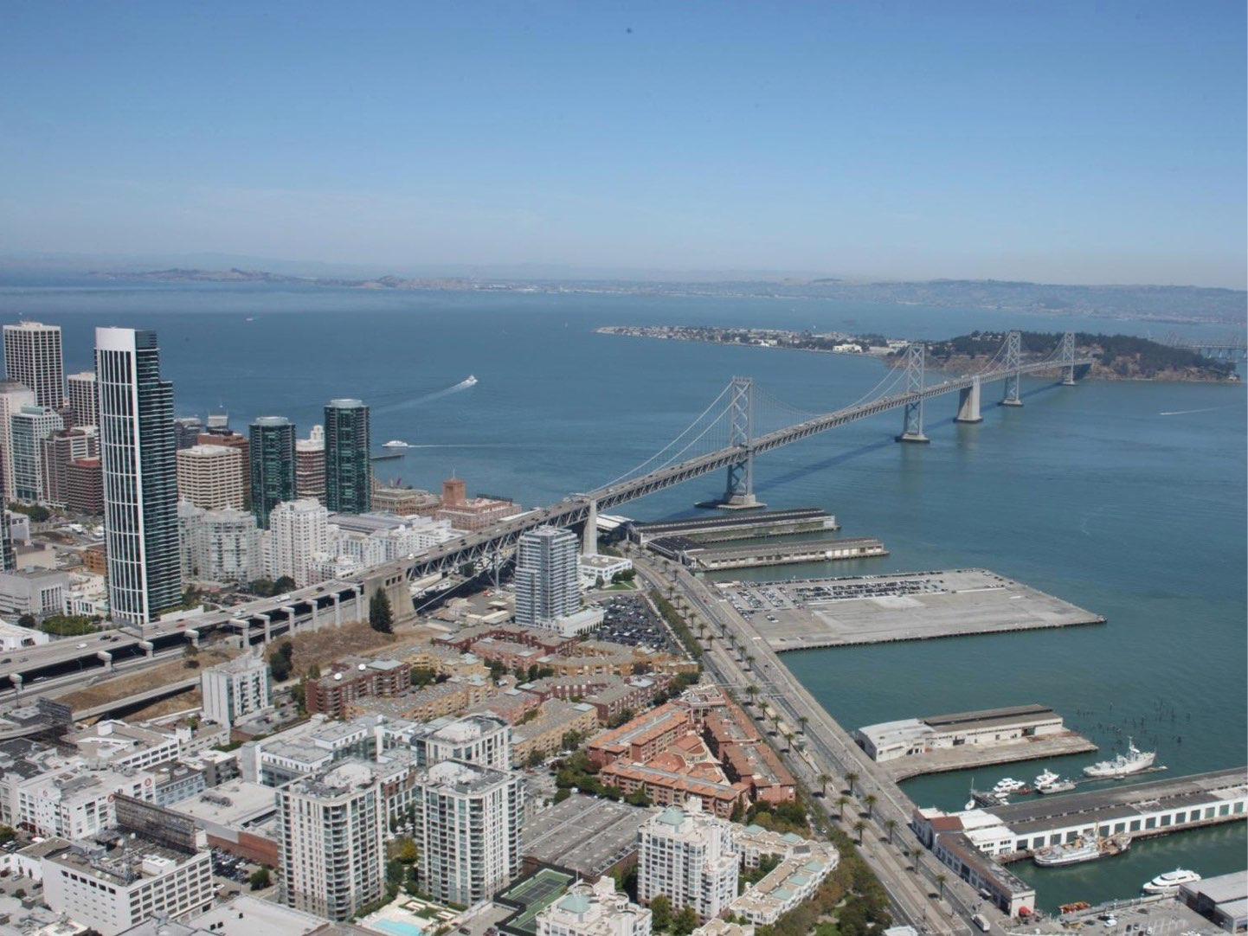
URBANSIM APPLICATION: PLAN BAY AREA
Policy Inputs to Model System
Transportation
Transit investments (Rail, Bus)
Roadway investments (GP, HOV, HOT, Bike, Pedestrian)
Pricing (Tolls, Congestion)
Land Use Regulations
City comprehensive Plans
Transit Oriented Development, Urban Villages & Centers
Subsidies, Impact Fees
Urban Growth Boundaries
Protec on of Environmentally-sensitive Areas

Slide 31
URBANSIM APPLICATION: PLAN BAY AREA
Outputs from Model System
Land and Development
Economics
Housing units by type, density, price (affordability)
Non-residential buildings by type, density, price
Acreage in agricultural land, forest, open space
Employment by sector and building type
Transportation
Accessibility, Mode Shares, Vehicle Miles Traveled, Congestion Delay
Demographics
Households by income, size, life cycle
Environment
Greenhouse Gas Emissions
Pollution

Slide 32
URBANSIM APPLICATION: PLAN BAY AREA
Increase non-auto mode share
Reduce VMT per capita
Maintain the transportation system
ECONOMY
Increase gross regional
product
Economic Vitality
Transportation System Effectiveness
Reduce per-capita greenhouse gas emissions from cars and light-duty trucks
Reduce premature deaths from exposure to particulate emissions
Reduce injuries and fatalities from collisions
Increase average daily time spent walking or biking
Climate Protection
ENVIRONMENT
Direct all non-agricultural development with the urban footprint
Healthy And Safe Communities
Open Space And Agricultural Preservation
Decrease housing and transportation costs as a share of low-income household budgets
EQUITY
House all of the region’s projected housing growth
Adequate Housing
Equitable Access

Slide 33
URBANSIM APPLICATION: PLAN BAY AREA
 | Target | Goal | No Project | Preferred | Transit Priority Focus | Network of Communities | Equity, Environment &Jobs
1 | Reduce per-capita CO₂ emissions from cars and light-duty trucks | -15% | -8% | -18% | -16% | -16% | -17%
2 | House the region's projected growth | 100% | 100% | 100% | 100% | 118% | 100%
3a | Reduce premature deaths from exposure to fine particulates (PM_{2.5}) | -10% | -71% | -71% | -72% | -69% | -72%
3b | Reduce coarse particulate emissions (PM₁₀) | -30% | -16% | -17% | -17% | -14% | -18%
3c | Achieve greater particulate emission reductions in highly impacted areas | Yes | Yes | Yes | Yes | No | Yes
4 | Reduce the number of injuries and fatalities from all collisions | -50% | +18% | +18% | +17% | +23% | +16%
5 | Increase the average daily time walking or biking per person for transportation | +70% | +12% | +17% | +18% | +13% | +20%

Slide 34
Questions?

Slide 35
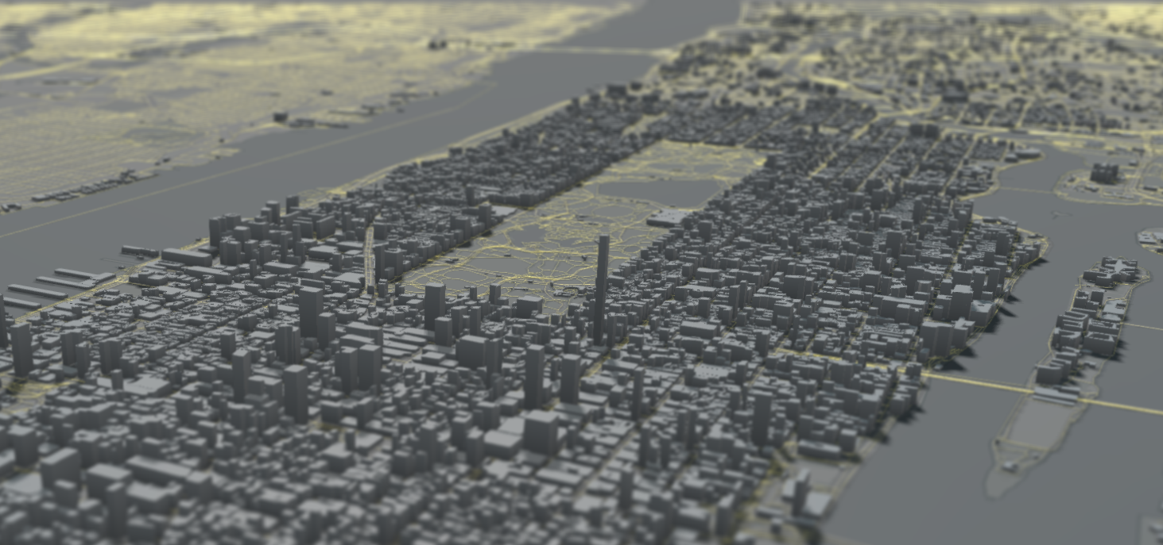
DEMO

