Slide 1
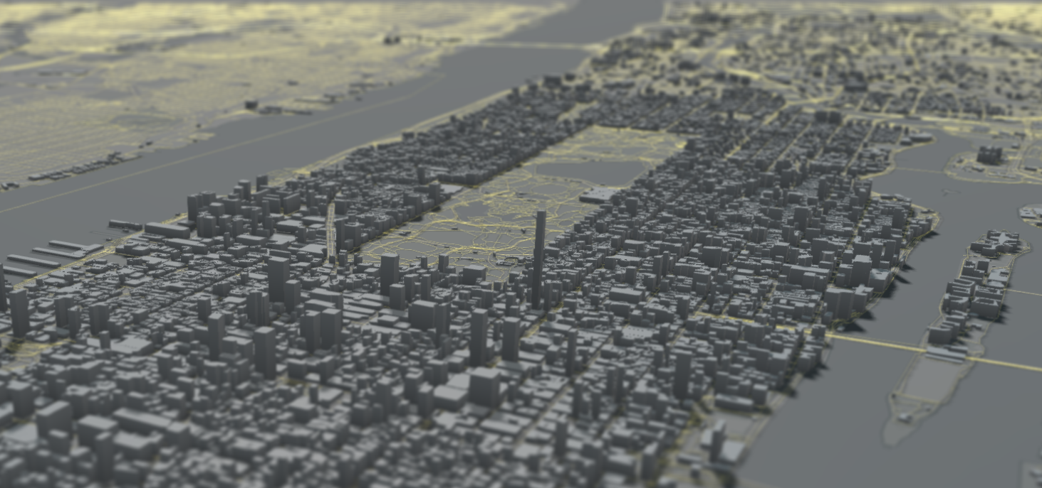
UrbanSim
Daniel Jerrett, PhD
Chief Economist, UrbanSim Inc.

Slide 2
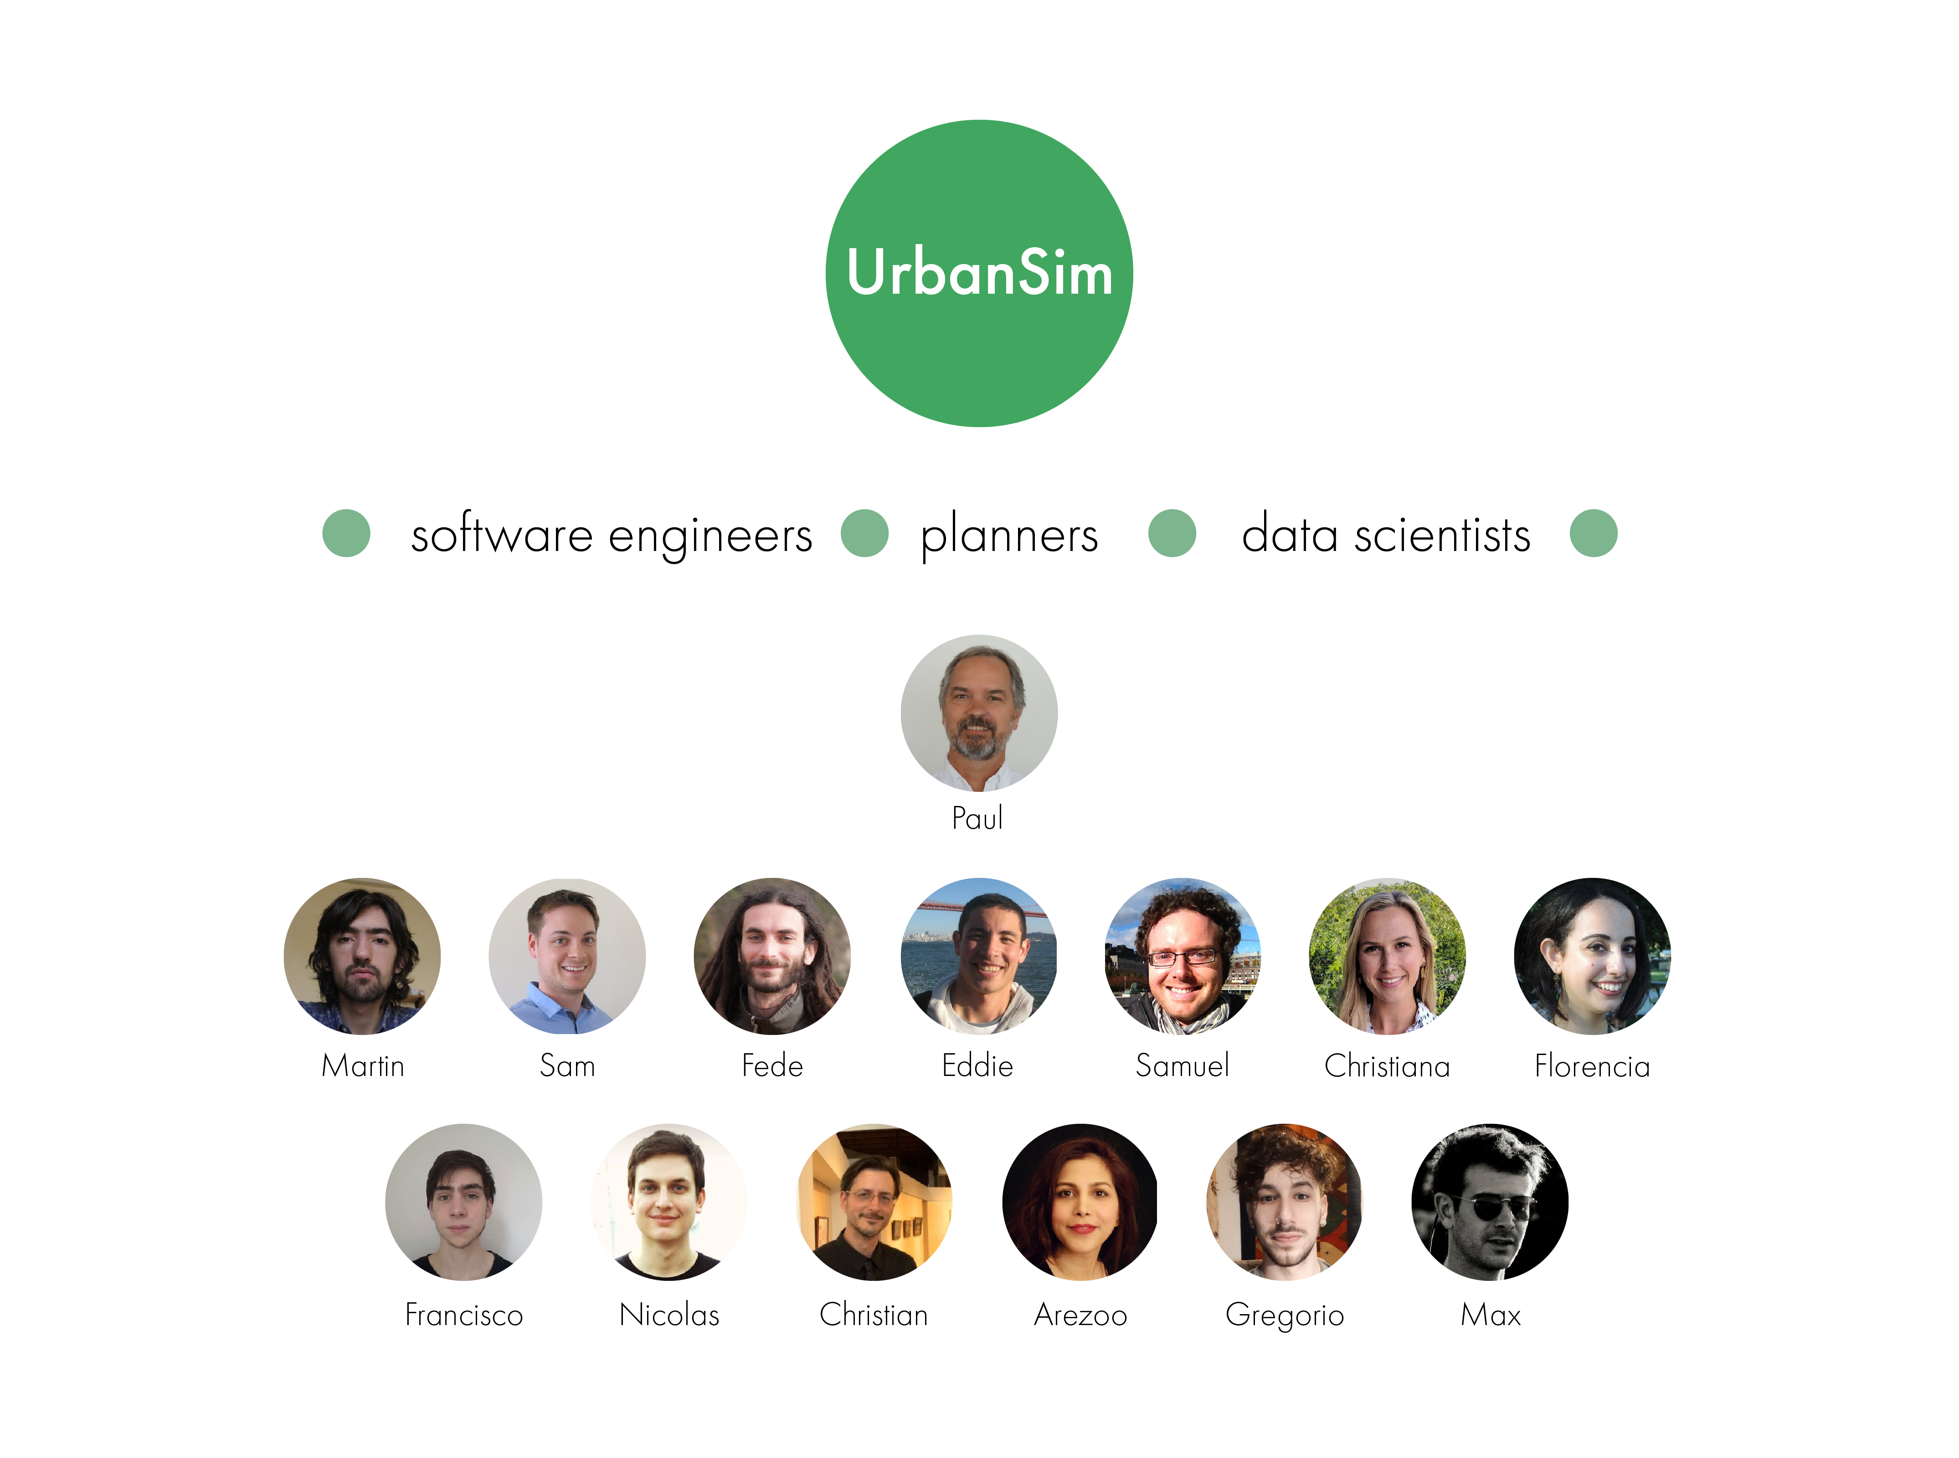

Slide 3
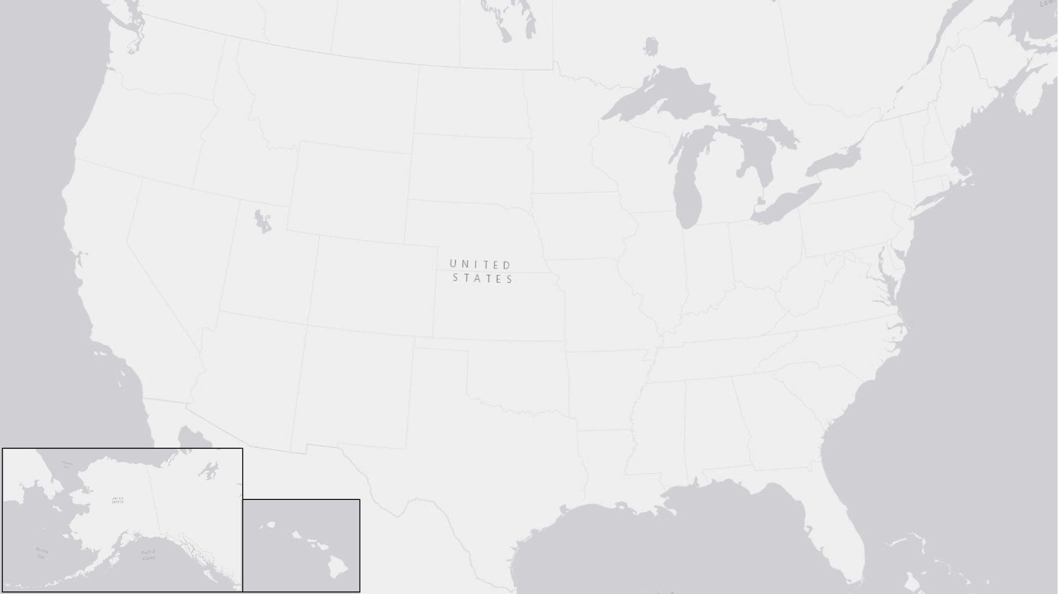
Seattle
Minneapolis-
St Paul
Eugene-Springfield
Salt Lake City
Detroit
Ft. Collins
Chicago
San Francisco
Denver
Urbana-Champaign
Colorado Springs
Kansas City
Phoenix
Nashville
San Diego
Albuquerque
Durham
Tucson
Austin
Vancouver
Paris
Honolulu
Johannesburg

Slide 4
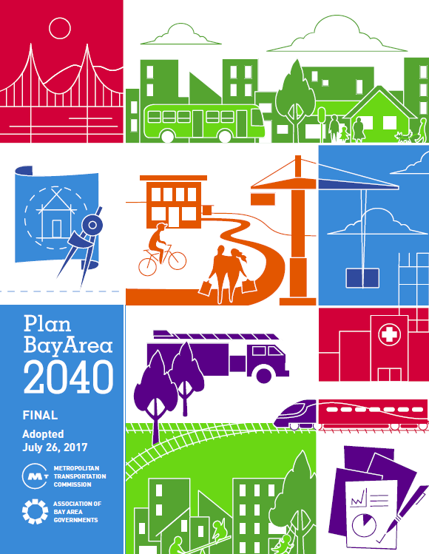
Why model land use change?
To forecast socio-economic and travel outcomes
To evaluate alternative land use and transportation policies and assumptions
To provide policy makers and planners information needed to allocate scarce resources
At the regional level:
Metropolitan Planning Organizations (MPOs) forecast and model land use over 30 year horizons to inform Regional Transportation Plans (RTP)
Source: Plan Bay Area 2040, MTC & ABAG 2017

Slide 5
UrbanSim is:
Geographic levels of analysis:
A microsimulation land use model
Designed to support the need of Metropolitan Planning Organizations (MPOs), cities and other organizations for analyzing the potential effects of land use policies and infrastructure investments on the development and character of cities and regions
Developed as a Open Source model system initially funded by 6 NSF grants
Based upon research led by Paul Waddell at the University of California, Berkeley
Parcels
Census Block
Arbitrary Zone
Notes:
UrbanSim is a microsimulation land use model designed to assess the potential impacts of alternative transportation infrastructure plans and land use regulations and the interactions between land use, transportation, the economy, and the environment. It was developed as a Open Source model system initially funded by 6 NSF grants based upon research led by Paul Waddell at the University of California, Berkeley and is actively used by a number of MPOs in the US.
There are now three standard geographic level of analysis templates: the most detailed at the parcel level where land use decisions are made, to the census block which provides a standardized data stricture using public data for the entire nation, and then the zone mainly for use out side of the united states.

Slide 6
UrbanSim:
Simulates the behavior of decision-making agents that participate in the real estate market
Simulates urban development as a dynamic process over time and space
Simulates the land market as the interaction of demand and supply, with prices and rents adjusting to clear the market
Explicitly incorporates governmental policy assumptions and evaluates policy impacts by modeling market responses
UrbanSim simulates agents interacting within real estate markets
Notes:
UrbanSim works by simulating the behavior of decision-making agents that participate in the real estate market (e.g. households, employers, and real estate developers),
represents urban development as a dynamic process over time and space (as opposed to a cross-sectional or equilibrium approach),
Simulates the land market as the interaction of demand and supply, with prices and rents adjusting to clear the market (trade off housing costs, accessibility, and housing and neighborhood amenities).
Can represent the housing market by tenure and building type, evaluates policy impacts by modeling market responses, and
is rooted in random utility theory and uses logit models for the implementation of demand components.
Land use policies constrain what developers can build, and transportation plans modify accessibility patterns, which influence the attractiveness

Slide 7
What can UrbanSim analyze?
Land use information (e.g. real estate development and prices, and the location and types of households and businesses) for input to a travel model.
The effects on land use patterns from alternative investments in transportation infrastructure, or in alternative levels of service or pricing.
The effects of changes in land use regulations on land use, including the effects of policies to relax or increase regulatory constraints on development of different types.
The effects of changes in the macroeconomic structure or growth rates on land use.
The possible effects of changes in demographic structure and composition of cities on land use, and on the spatial patterns of clustering of residents.
Notes:
Transportation
Transit investments (Rail, Bus)
Roadway investments (GP, HOV, HOT, Bike, Pedestrian)
Pricing (Tolls, Congestion)
Land Use Regulations
Comprehensive Plans
Transit Oriented Development, Urban Villages & Centers
Subsidies, Impact Fees
Urban Growth Boundaries
Protection of Environmentally-sensitive Areas
Macro Assumptions

Slide 8
UrbanSim Data Flow
External Models
Macroeconomic
Model
Travel Demand
Model System
Inputs
Control Totals
-Population
-Jobs
Travel Data
- Generalized Cost
- Travel Time
- Composite
Utility
User Inputs
-Development
Constraints
Models
Household &
Employment
Relocation
Models
Household &
Employment
Transitional
Models
Household &
Employment
Location Choice
Models
Real Estate
Price & Rent
Models
Real Estate
Development
Model
Outputs
Jobs &
Households
Buildings

Slide 9
Base Data: Parcel model
Ancillary data
Parcels
Travel model skims
Known upcoming development
Pipeline development projects
Buildings
Residential units
Tenure
SQFT
Building type
Travel time and accessibility
Street network
Transit network
Calibration and validation data
Observed growth targets
Households
Control totals
Synthesized
Macro trends
Vacancy rate
Persons
Development constraints
Undevelopable land
Jobs
Business establishments
Development capacities
Zoning

Slide 10
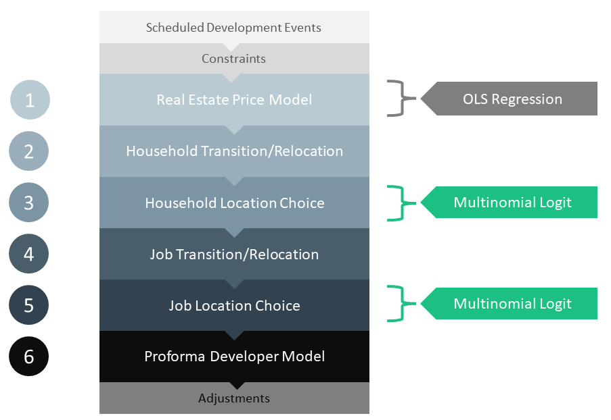
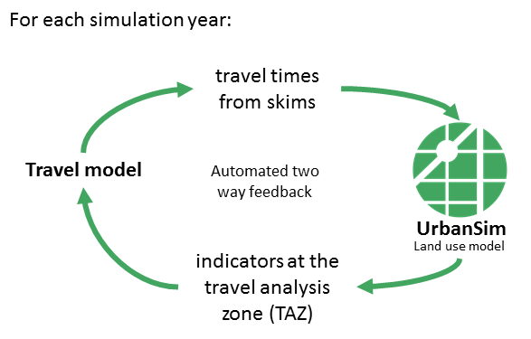
UrbanSim Workflow
Annual time steps:
Notes:
The simulation proceeds in annual time-steps where each simulation year, a set of models are run in sequence.
First, real estate prices are predicted.
Then new and relocating households are selected, and these households then make a location choice in the region.
Next, new and relocating business establishments are selected, and then these establishments make a location choice.
And then, turning to the supply side of the real estate market, the location and type of new real estate development is simulated.
Resulting indicators can be exported each year and send to external models such as a travel model in order to have a two-way feedback between UrbanSim and the travel model, capturing the complex interrelationships between transportation and land use.

Slide 11
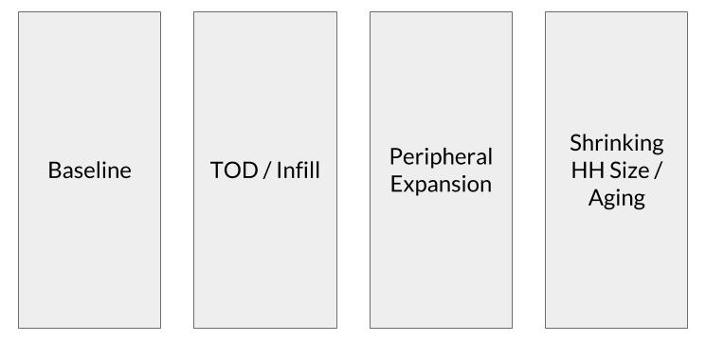
What does a typical modeling workflow look like?
Collect & clean input data
Jurisdictional outreach
&
incorporate feedback
Model specification
Model estimation
Model calibration
Model validation
Model development
Scenario development
Travel model integration
Sensitivity testing
Operational use
Analyze alternative scenarios

Slide 12
What is an UrbanSim scenario?
An UrbanSim scenario is a bundle of policies and assumptions. A user can specify which of the uploaded input data (i.e. travel model skims, household control totals (or growth rate), development projects, development constraints, and model adjustments) to apply to a given scenario through the new scenario composer.
👥
Household Control Totals
👥
Development Projects
Specify which of the user uploaded household control totals to use (representing detailed demographic information) or specify household growth rate.

Select which of the development projects to consider in this scenario by selecting the relevant development tags

Employment Control Totals

Zoning Constraints
Specify which of the user uploaded employment control totals by sector to use or specify employment growth rate.
Select which of the defined zoning constraints to apply in this scenario by selecting the relevant constraints tags.
Travel Model Skims
Model Adjustments
Specify which of the user uploaded travel model skims to use and to what range of years they will be applied.
Select which of the model adjustments incorporated through stakeholder feedback to apply in this scenario by selecting the relevant Adjustment tags.

Slide 13
UrbanSim can be implemented at multiple geographies
UrbanSim is an open source simulation platform for supporting planning and analysis of urban development, incorporating the interactions between land use, transportation, the economy, and the environment.
Parcel - Level Model
Census
Block – Level Model
Zone - Level Model
The most detailed and powerful model applications of UrbanSim using individual buildings and parcels.
Users of the block or zone versions can convert to the parcel version easily when uploading local parcel data.
The census block models are pre-built from public data for most metropolitan areas in the United States.
This is the fastest way to begin using UrbanSim.
Users are required to upload zonal data whereby they will be able to build and calibrate an UrbanSim model.
For metropolitan areas outside the United States, this is the fastest way to build an UrbanSim model.
International
United States
International

Slide 14
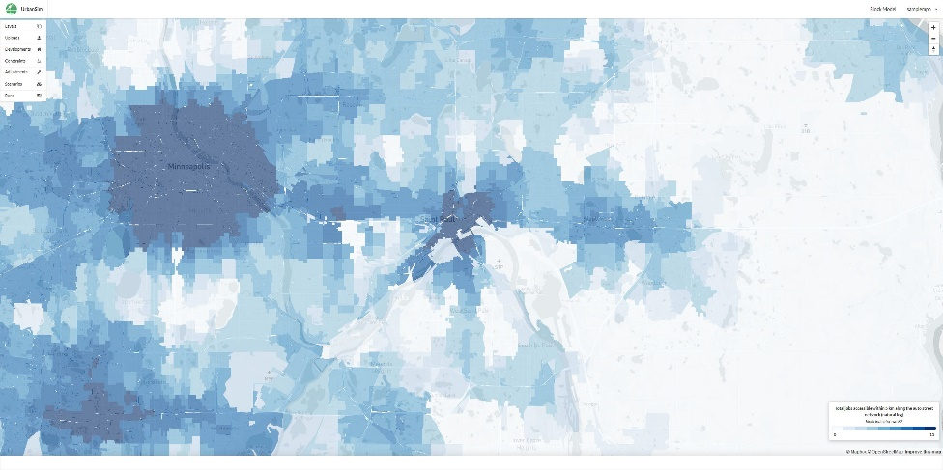
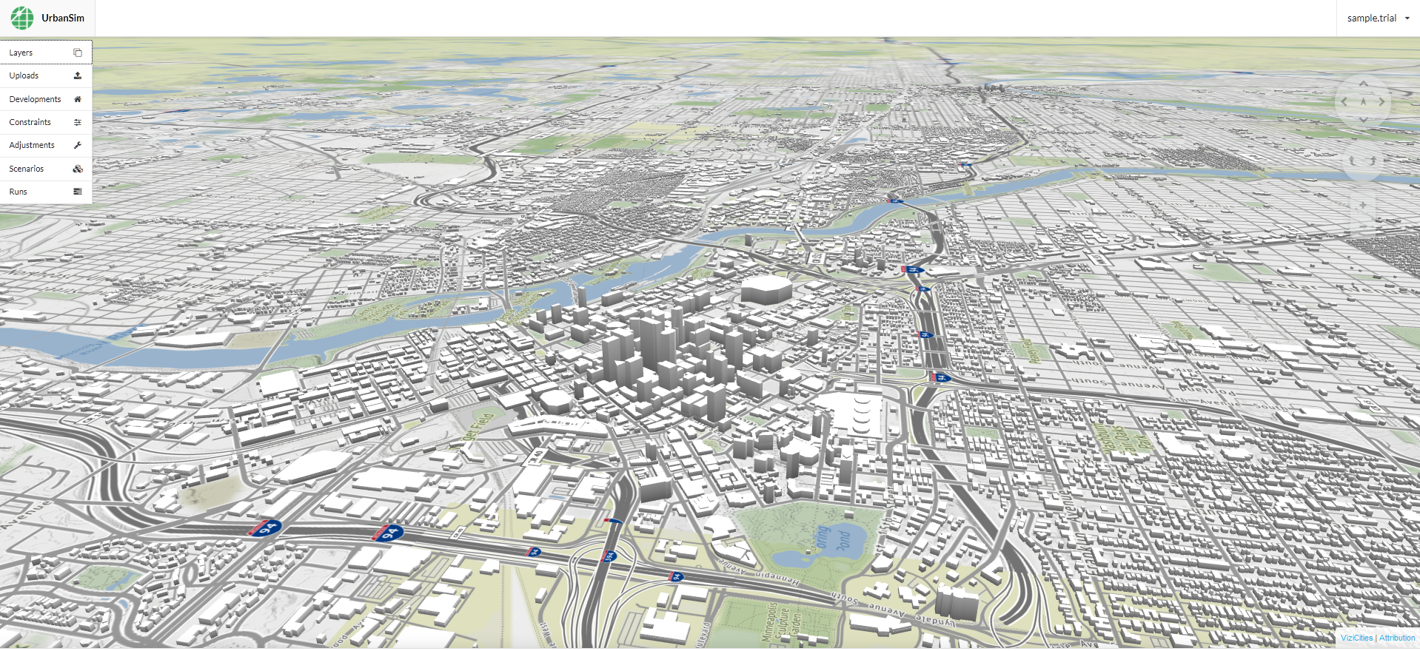
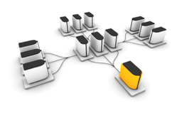
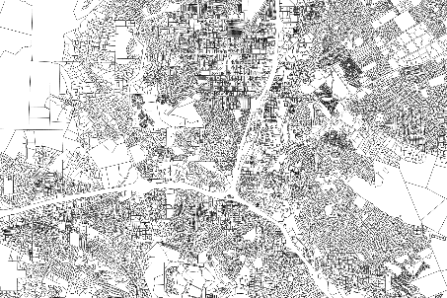
UrbanCanvas Modeler
UrbanCanvas:
Web browser user interface (2D/3D map)
External models
Cloud storage and computing
Shared regional database
Notes:
Now what we have done at UrbanSim is developed a new way to utilize the UrbanSim land use model in a manner that attempts to address many of the pain points MPOs go through when developing their land use model and RTP process.
Key to this is to wrap UrbanSim with cloud infrastructure to utilize scalable on demand computing, removing the need for MPOs to maintain in house computing resources, this encourages sensitivity testing and rapid prototyping of multiple scenarios.
All this occurs within a 2D/3D user interface in the web browser, with the ability to integrate simulation results in a web map or export for use outside the platform. Enables a wide variety of stakeholders (planners, public agencies, citizens and advocacy groups) to explore the potential consequences of alternative public policies and investments means of communicating simulation results from UrbanSim to policy makers and the public. Allowing for feedback to be incorporated from the early stages and follow this through more detailed planning stages of the modeling effort.
Can create scenario inputs such as development constraints and development projects in the pipeline and track data in a transparent way over time.
Can leverage a shared data repository, enabling coordination and collaboration among users within the same organization, as well as across organizational and geographic boundaries and can include all inputs to the model in a standard data schema: base data, parcels, buildings, zoning, TAZs, transportation networks, simulation results

Slide 15
What is the Urban Canvas Modeler Platform?
The Cloud Platform is a cloud-based urban simulation and visualization platform that leverages state-of-the-art urban simulation, 3D visualization, and shared open data allowing users to explore, gain insights into, and develop and evaluate alternative plans to improve their communities.
Design
Simulate
Visualize
Design scenarios based on existing and proposed policies interactively and visually to simulate variations of land use and transportation plans. These scenarios can be compared across various attributes to allow regional planners to make calculated and informed decisions.
Simulate the regional real estate market at the level of individual decision-makers such as households, employers, and real estate developers. UrbanSim runs on the cloud, for one or many scenarios, and rapidly generates results.
Use a large and flexible portfolio of indicators to gain insight into existing conditions and the effects of alternative scenarios. Visualize existing conditions and indicators in a dynamic 3D web mapping environment, and invite users to review results, or share them with the public.

Slide 16
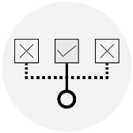
What is the UrbanCanvas Modeler Platform
UrbanCanvas Modeler is a cloud-based urban simulation and visualization platform that leverages state-of-the-art urban simulation, 3D visualization, and shared open data allowing users to explore, gain insights into, and develop and evaluate alternative plans to improve their communities.
UrbanSim
Create Scenarios
Harness the power of the UrbanSim microsimulation-based engine.
Compose multiple scenarios representing a suite of land use and transportation policies.
Input Data
Run Multiple Simulations on the Cloud
Use our precompiled national datasets and upload your own local data.
Harness the processing power of the cloud.
Track Developments
Visualize Indicators
Incorporate future developments.
Visually interrogate simulation results.
Edit Constraints
Model Adjustments
Incorporate future zoning constraints.
Incorporate stakeholder feedback.

Slide 17
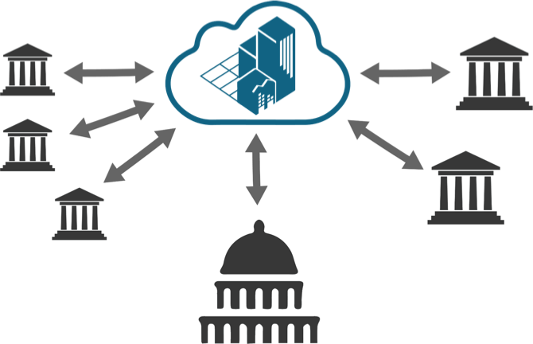
Open Data for Planning
UrbanCanvas Reader

Slide 18
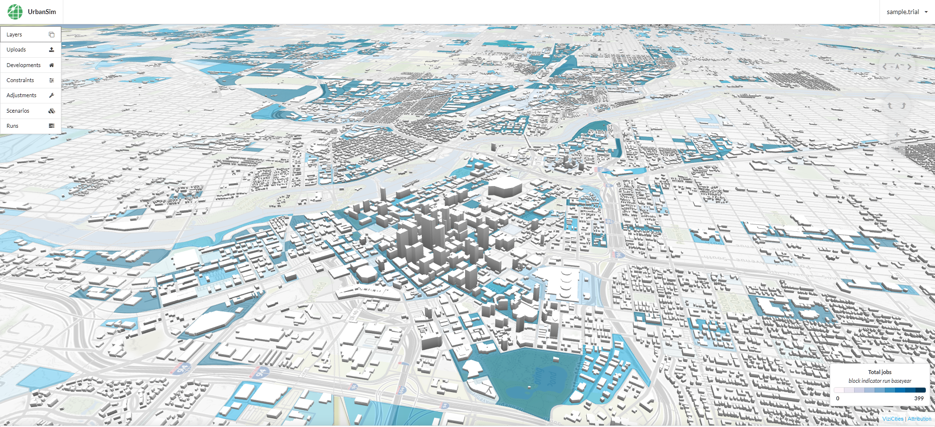

Slide 19
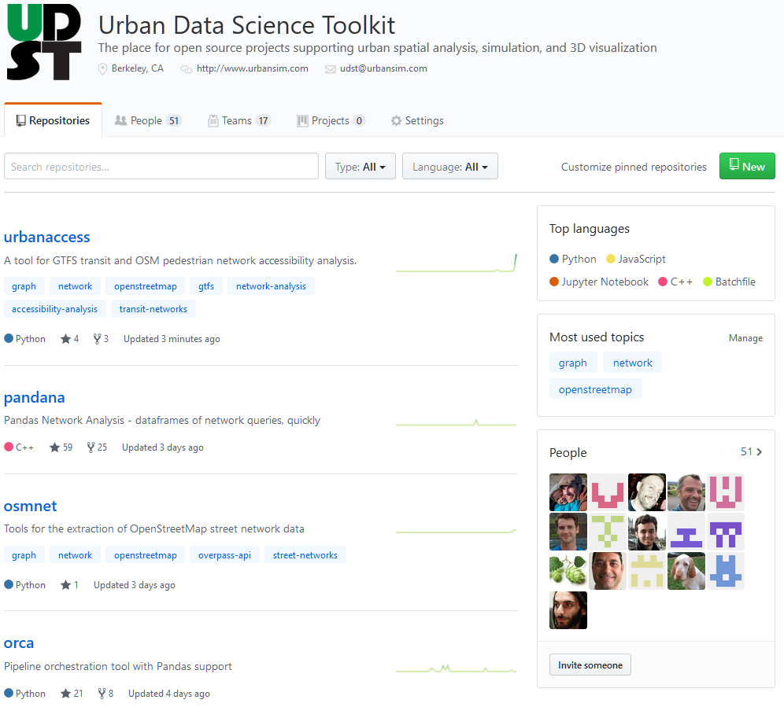
Modeling Software: Open Source Urban Data Science Toolkit
Urban Data Science Toolkit
UrbanSim
A platform for simulating urban real estate markets and their interaction with transportation.
ORCA
A generalized framework for data processing and orchestration to support UrbanSim, ActivitySim, and other types of modeling.
ActivitySim
A platform for simulating Activity-Based Travel.
Pandana
A fast network accessibility engine for computing accessibility metrics.
Spandex
Spatial Analysis and Data Extraction.
Synthpop
A Population Synthesizer.
ChoiceModels
A library of flexible discrete choice models, including Multinomial Logit, Nested Logit, Mixed Logit, and Latent Class Models.
UrbanAccess
A library to obtain, clean, merge and analyze GTFS Transit Networks and OSM networks for pedestrian and transit accessibility.

Slide 20
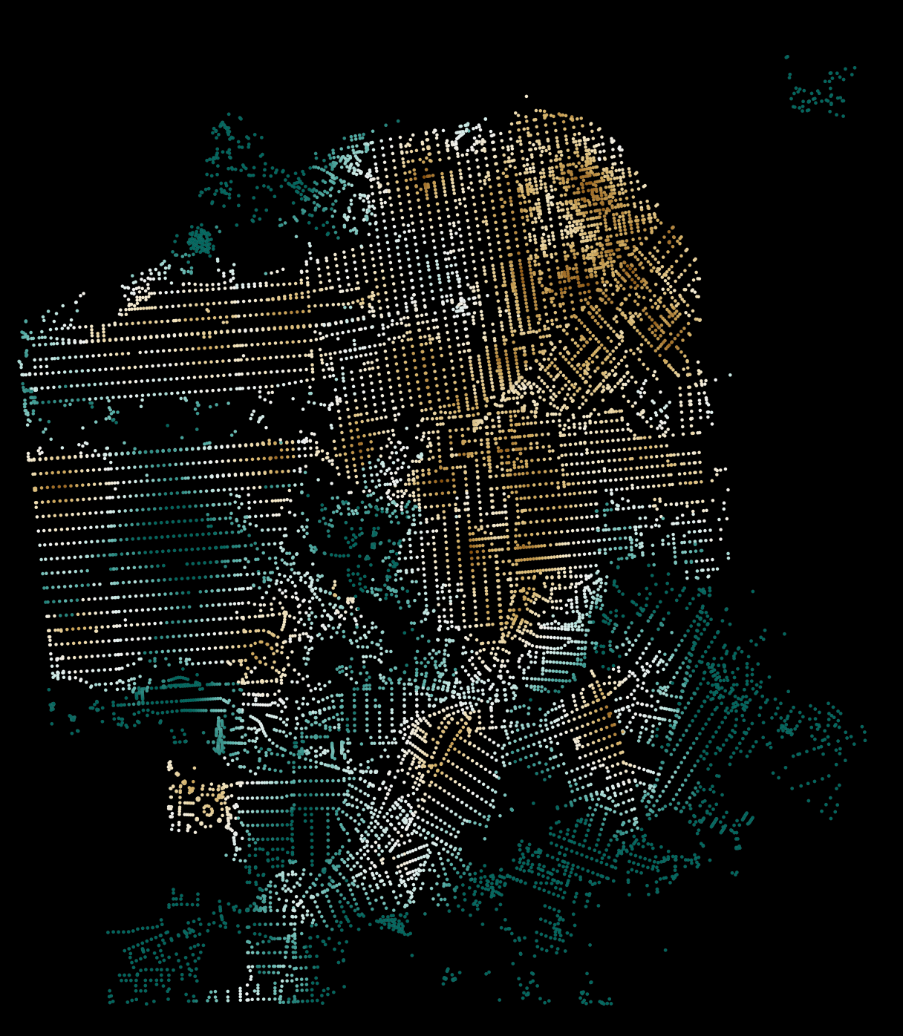
Pandana
A fast network accessibility engine for computing accessibility metrics.

Slide 21
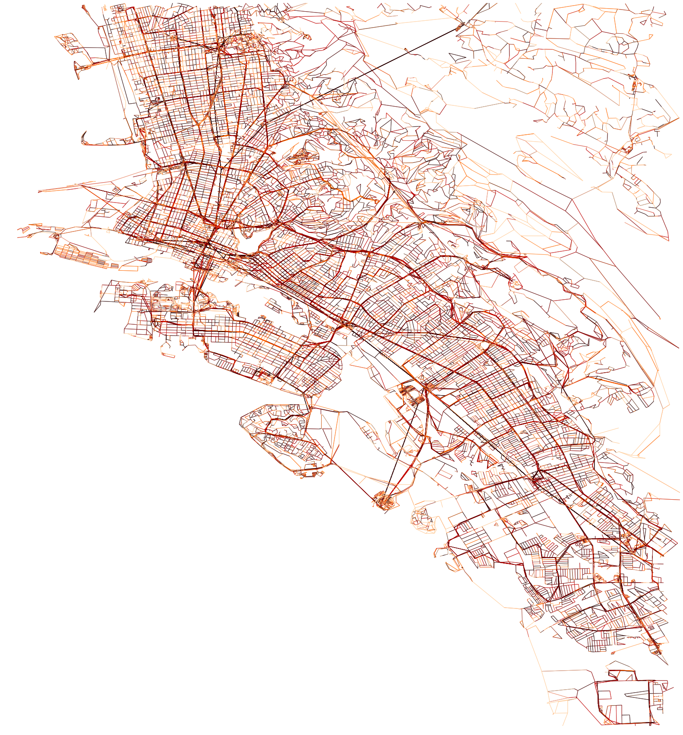
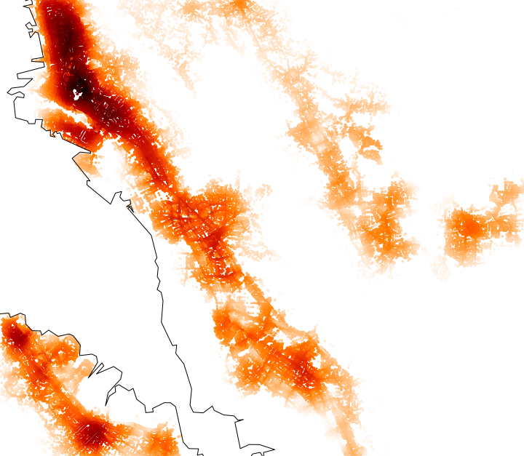
Open Source Tools for Urban Models
UrbanAccess
Quickly compute transit and pedestrian networks for accessibility analyses.
Travel time
integrated network
Job accessibility

Slide 22
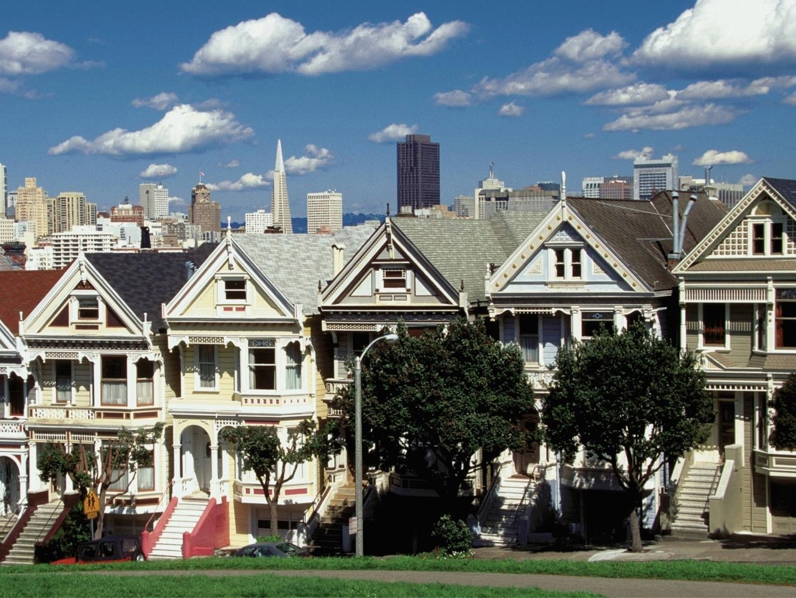
First regional plan to integrate transportation, land use, and housing (Sustainable Communities Strategy)
Initiated by California Senate Bill 375

Slide 25
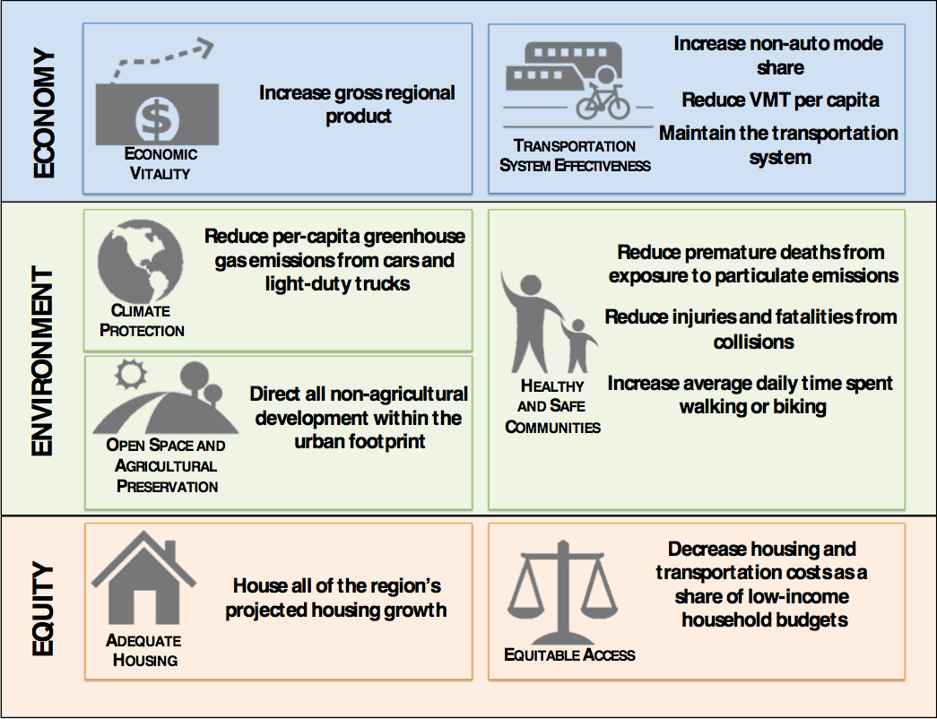

Slide 26
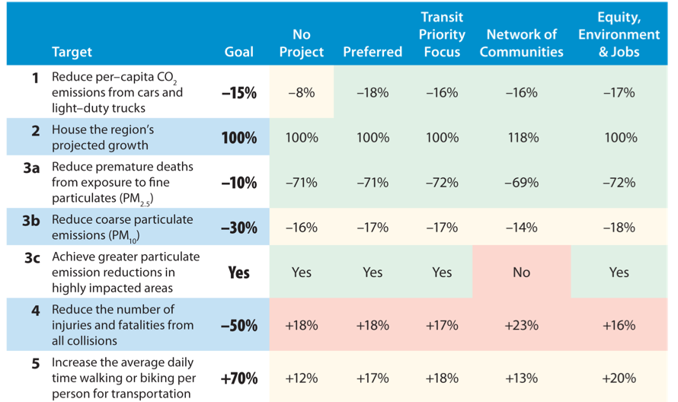

Slide 27
Discussion

