Slide 1
TDOT Traffic Count Program Review
Preston Elliott, KCI & KB Aboagye, TDOT

Slide 2
Project Scope
Review of Current Count Program
Internal and External Outreach
Review of Surrounding and Peer State Practices
Needs and Recommendations

Slide 3
Project Scope
Review of Current Count Program
Procedures and manuals
Collection schedule (required and typical)
Collection scope (geography, functional class, etc.)
Collection methods (ATR, EDL, CC, etc.)
Types of data (volume, vehicle classification, travel time, occupancy, multimodal, etc.)
Users (internal and external)
Responsibility (staff, consultant, etc.)
Current quality assurance methods
Processing, final format, and storage
Notes:
Procedures and Manuals
Collection schedule – 24 hours every year / 48 hours every 3 years
Collection scope – how many samples on roads of different functional classification
Collection methods – continuous versus coverage
Types of data – different divisions collecting different types (volume, classification, travel times, multimodal, etc.)
Users – What are other divisions using it for? How useful/important is data for external users?
Responsibility – staffing issues?
Current quality assurance methods
Processing, final format, and storage

Slide 4
Project Scope
Internal and External Outreach
Interview TDOT’s internal partners (Long-Range Planning, Traffic Operations, STID, etc.)
Interview external partners (MPOs and RPOs)
Online survey for other partners (municipalities, universities, professional organizations, etc.)

Slide 5
Project Scope
Review of Surrounding and Peer State Practices
Currently looking at:
Ohio
Oregon
Minnesota
Florida

Slide 6
Project Scope
Needs and Recommendations
Additional data needs, requests, and wants
Real-time data, emerging technologies, etc.
Partnering with MPO data collection efforts and other municipalities
Statewide guidance for traffic collection

Slide 7
Findings To-Date
In general, TDOT:
Is amenable to data sharing with partners
Needs standardized methodologies throughout the program:
How to collect traffic data for sharing purposes?
How to choose/prioritize new count locations?
How to collect WIM data statewide?
How to improve vehicle classification counts?
Has challenges associated with meeting HPMS sampling requirements
Internal Engagement

Slide 8
Findings To-Date
In general, MPO partners:
Have a strong understanding of the availability and usefulness of TDOT data
Primarily use TDOT’s AADT and crash data
Are willing to share locally collected data
Need more data on Federal and State routes
Are very interested in turning movement counts
Desire more communication regarding count station removal/addition and count timing
External Engagement

Slide 9
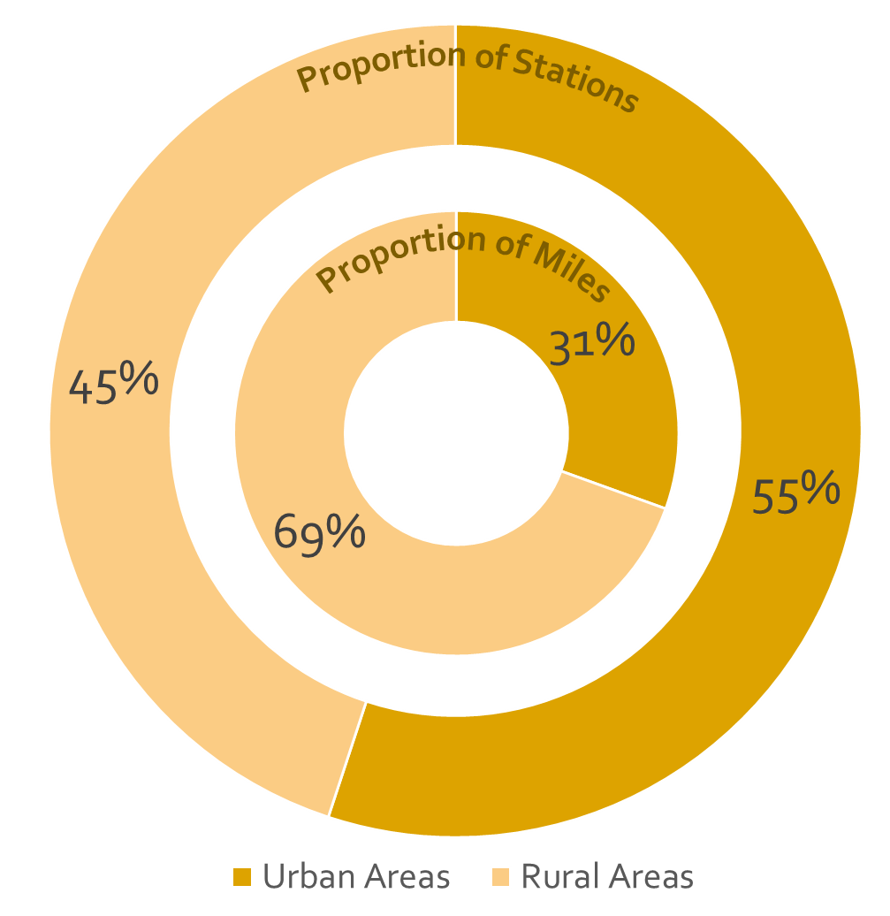
Findings To-Date
Proportion of Stations
~12,500 Count Stations
Proportion of Miles
600 Interstates
5,100 Arterials
6,800 Collectors
Data Analysis

Slide 10
Findings To-Date
20%
14%
Data Analysis
35%
9%
16%
7%
Notes:
30% on roads with less than 1000 AADT
One thing mentioned by multiple MPOs in the survey is the collection of data on low-volume facilities.
Would be willing to sacrifice those counts for more counts on high-volume facilities.

Slide 11
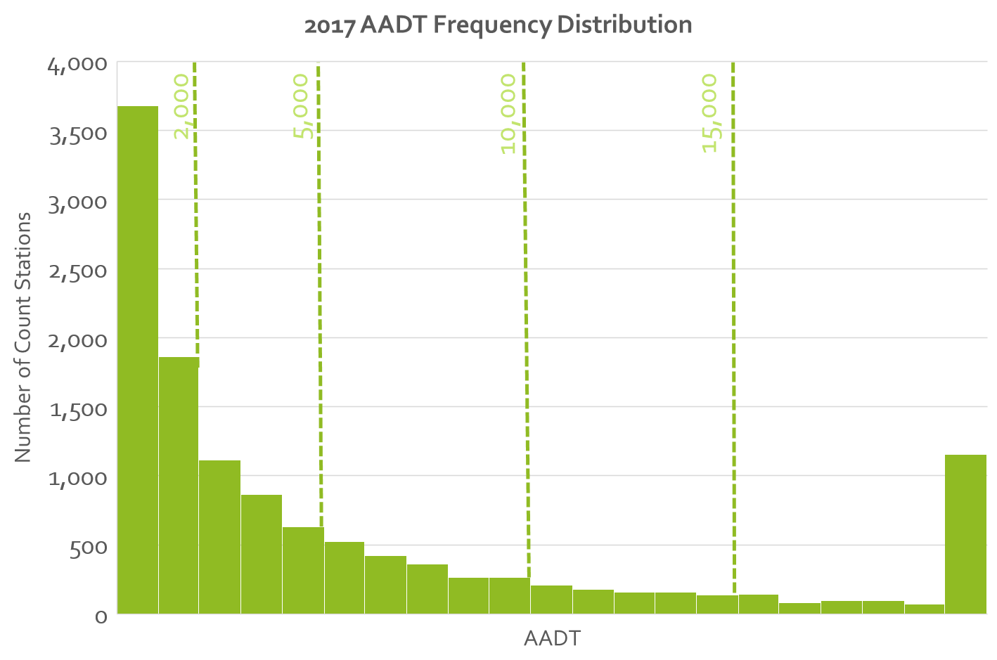
Findings To-Date
2,000
5,000
10,000
15,000
Data Analysis
Notes:
5530 stations with less than <2,000 AADT = 44%

Slide 12
Findings To-Date
Shelby
Hamilton
Data Analysis
Davidson
Knox
Notes:
Expected linear relationship although lots of outliers particularly on the high side

Slide 13
Findings To-Date
Williamson
Rutherford
Data Analysis
Shelby
Hamilton
Notes:
A lot of the disparity comes from high-growth counties like Williamson, Rutherford,

Slide 14
Findings To-Date
Shelby
Hamilton
Data Analysis
Davidson
Knox
Marshall
Maury

Slide 15
Findings To-Date
9th Most Classified Miles
16th Highest Population
18th Highest Employment
65th Highest # of Count Stations
Maury County
11th Most Classified Miles
15th Highest Population
11th Highest Employment
41st Highest # of Count Stations
Madison County
Data Analysis
58th Most Classified Miles
47th Highest Population
48th Highest Employment
8th Highest # of Count Stations
Marshall County

Slide 16
External Outreach Plan
TNMUG Group Discussion
Additional Outreach with MPOs, RPOs, and Municipalities
Online Survey for Key Industry Partners (ACEC, TSITE, TAPA, universities, etc.) and for Cities and Counties
Notes:
Municipalities – larger ones and the ones we know collect traffic data

Slide 17
Discussion Items for Today
Beyond current data collected, what is your priority for the following:
Vehicle Classification
Travel Time
Turning Movement Counts
Occupancy
Weigh-in-Motion
Relative to TDOT’s traffic data, what are your thoughts/opinions on coverage, frequency/duration, quality, etc.?
Do you know of any count programs conducted by local municipalities within your planning areas?
Other thoughts/comments on this topic?

