Slide 1
TNMUG – MPO Data Needs Discussion Knoxville Regional TPO Perspective
November 29, 2018

Slide 2
Summary of Major Data Uses for Transportation Planning at Knoxville TPO
Travel Demand Model Development/Calibration/Validation
FAST Act Performance Management
Other Multi-Modal Systems Performance Information to Identify Needs and Deficiencies
Transportation Conformity (MOVES Model Inputs)

Slide 3
Knoxville Regional Travel Model Background - Geography
10 counties – 3,725 sq. mi.
Population – 978,700 persons
TAZ – 1,108 zones
Network – 3,000 miles
Covers Knoxville and Lakeway MPAs

Slide 4
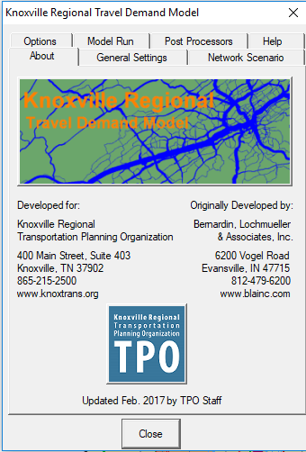
Knoxville Regional Travel Model Background – Chronology
2000 – HH Travel Survey
2002 – New Trip Based Model
2005 – Model Peer Review
2007 – External Survey (Interstates)
2008 – HH Travel Survey (Expanded Area)
2009 – Hybrid Trip/Tour Based Model
2012 – Added Geography (LAMTPO), 2010 Base Year (Decennial Census Info)
2017 – Minor Update, Validate to 2014
2019 – Model Peer Review?

Slide 5
Knoxville Regional Travel Model – Next Steps
Long Range Plan 4-year Update Cycle drives the Model Update Schedule – Next LRTP due by June 2021
Considering Model Peer Review to Determine Next Platform (Hybrid vs. Full Activity Based or Other)
Determine Data Needs to Support Next-Gen Model
Land Use Information
Roadway/Transit Network
Travel Behavior Data
Non-Household Travel (Commercial and External Traffic)
Determine Data Availability, Acceptability (age, coverage, etc) and COST

Slide 6
TPO Data Needs – Public vs. Proprietary ($$$)
Many of the Data Sources Needed to Support Travel Demand Model and Transportation Planning are Publicly Available or Collected Directly by TDOT
Roadway Network Attributes – ETRIMS
Traffic Counts
Census Data for Population Characteristics
NPMRDS
Land Use Data – Parcel-based from Tennessee Comptroller (New)
Other Data Sources are Proprietary and Cost Money to Acquire or Collect:
Household Surveys
Employment Data
Freight Data
Travel Time Data (Non-NHS)
Cell Phone and Truck Origin-Destination Data

Slide 7
TDOT/MPO Data Coordination
Current Status of Data Acquisition (My Observation Only):
TDOT acquires proprietary data on as-needed basis for various planning efforts/studies
MPOs collect/purchase their own data or leverage TDOT data as available
Possible Future of Data Acquisition:
Convene forum of TDOT/MPO staffs to determine:
Common Data Needs, which ones are Scalable
Evaluation of Vendors
Data Update Cycles Needed
Cost Sharing Possibilities
Review Existing Data, opportunities to improve
Objective – Develop Data Acquisition “Plan”

