Slide 1
Data Acquisition Plan
Jaehoon Kim | Forecasting Office Supervisor | May 31, 2018

Slide 2
Survey on MPOs’ Needs
Survey Purpose
To know MPOs’ needs of commercial datasets
To know when MPOs need to obtain
To know preferred data vendors
Survey Structure
Target: 11 MPOs
Questions: Total 15 Questions were asked
Responded by 8 MPOs
Survey Period: Nov. 26 to 28, 2018

Slide 3
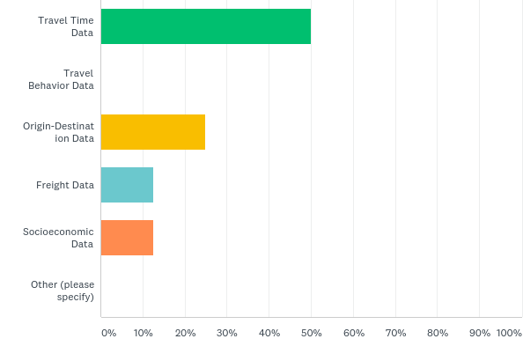
Survey on MPOs’ Needs
Q2: What kind of data do you need most urgently?

Slide 4
Survey on MPOs’ Needs
Q3: What is the purpose of the data that you selected in the previous question?
Data | Response (Q2) | Response (Q3)
Travel Time Data | 4 | TIP, Model Development, CMP report, PM3, TDM
Travel Behavior Data | 0
Origin-Destination Data | 2 | Corridor Planning, To know Travel Behavior
Freight Data | 1 | Freight Study in 2019
Socioeconomic Data | 0
Other | 0

Slide 5
Survey on MPOs’ Needs
Q4: When do you need the data?

Slide 6
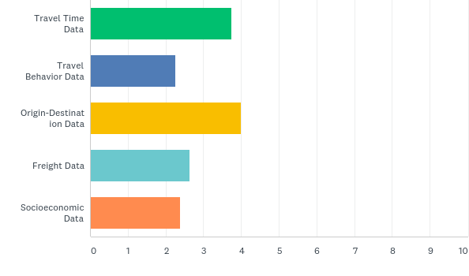
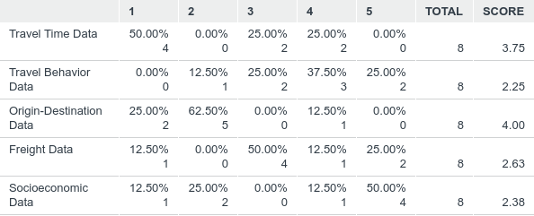
Survey on MPOs’ Needs
Q5: Please rank datasets in terms of your priority.

Slide 7
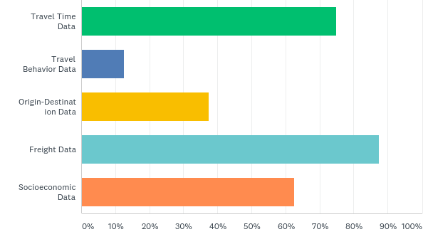
Survey on MPOs’ Needs
Q6: Please select datasets you need to use except for the travel demand model update.

Slide 8
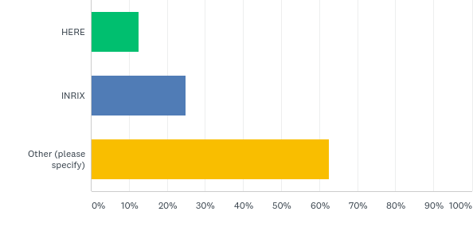
Survey on MPOs’ Needs
Q8: What data vendor do you prefer to obtain for the project?
-> Q8: What data vendor do you prefer to obtain for the travel time data?

Slide 9
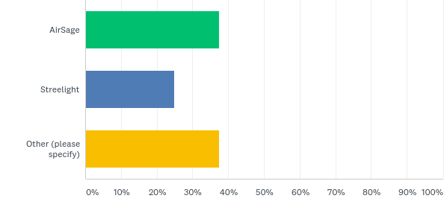
Survey on MPOs’ Needs
Q9: What data vendor do you prefer to obtain for the Origin-Destination Data?

Slide 10
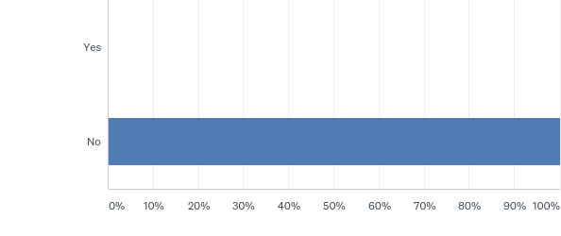
Survey on MPOs’ Needs
Q10: Did your organization participate in 2017 NHTS Add-ons?

Slide 11
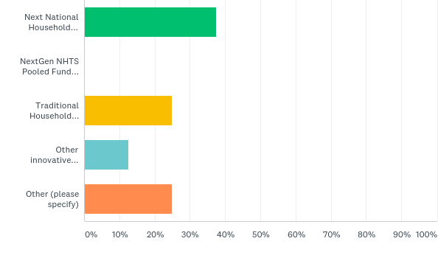
Survey on MPOs’ Needs
Q12: If no, how will you acquire the travel behavior data?

Slide 12
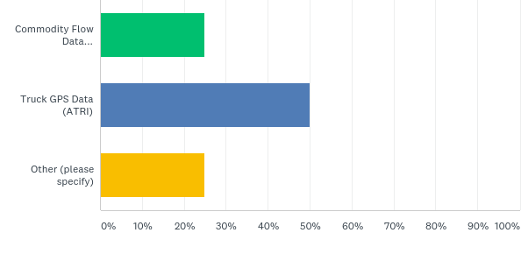
Survey on MPOs’ Needs
Q13: What kind of freight data do you prefer to obtain?

Slide 13
Survey on MPOs’ Needs
Q14: Please list all proprietary socioeconomic data that you want to acquire.
InfoGroup
Woods & Poole
CoStar

Slide 14
Survey on MPOs’ Needs
Q15: Please list all proprietary data which are not mentioned on previous questions, and you want to acquire
REMI/TREDIS
Turning movement counts on NHS
RITIS Analytics on NPMRDS
VisionZero Analysis of Crash Data

Slide 15
Commercial Data TDOT Purchased
No. | Data | Base Year | Licensed Users
1 | Air Sage | 2014 | RPM, RSG, TDOT, 11 TN MPOs, Universities in TN where a valid L.A. exists
2 | ATRI GPS data | 2013 | GPS Raw Data (RSG Only), O/D Matrix (TDOT)
3 | HERE | 2012 – 2017 April | TDOT Only
4 | InfoUSA | 2013, 2018 | TDOT, 11 TN MPOs
5 | Transearch | 2012, 2016 (waiting) | RPM, RSG, TDOT, 11 TN MPOs, Universities in TN for TDOT research
6 | W&P | 2014, 2016, 2017 | TDOT, 11 TN MPOs for TDOT model update

Slide 16
Data Acquisition Plan
TDOT will have internal discussion on next data acquisition.
More focus on ‘Travel Time Data’
Currently working with RITIS for cost estimation (tools/data)
Necessary to have the consent of all MPOs for cost sharing
Household Survey
Need to discuss with MPOs who plan to conduct regional HH travel survey
Other options
HH survey application (TDOT Research Project)
NextGen Pooled Fund Study
NOT sure when Next NHTS will be conducted
Contact TDOT Forecasting Office regarding following datasets
InfoGroup
Woods & Poole
Transearch

Slide 17
Contact Information
David Lee, PhD
Assistant Director
Long Range Planning Division
David.Lee@tn.gov
Office: (615) 253-4519
Cell: (615) 906-4555
Jaehoon Kim, PhD
Forecasting Office Supervisor
Long Range Planning Division
Jaehoon.Kim@tn.gov
Office: (615) 837-5464
Cell: (615) 587-1866

